Slide 1
Location:

Slide 2
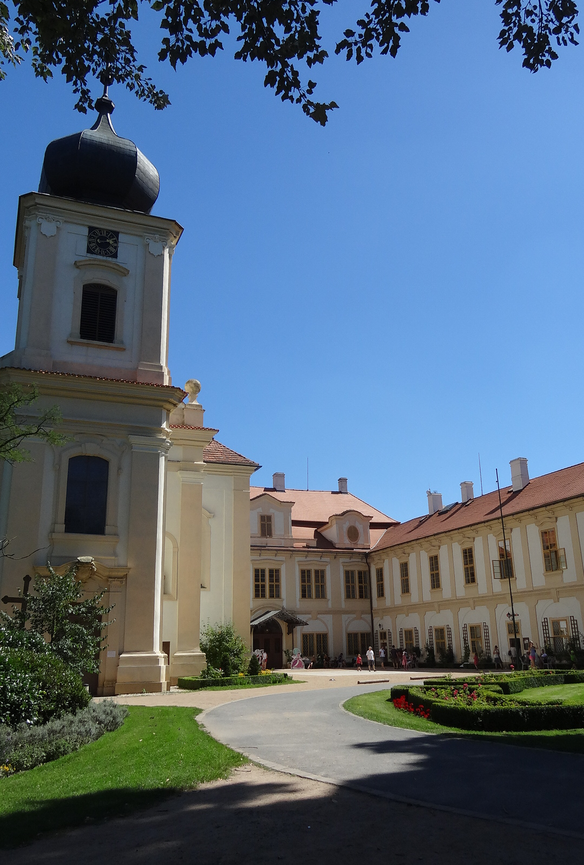
Castle Loučeň ROMANTIC BAROQUE SIGHT WITH ORIGINAL INTERIORS
History of the Castle
In the Middle Ages and early modern times not very famous or significant names of the owners took turns at Loučeň. The Thirty Years' War meant a principal change for the history of the manor. At that time, to be specific in 1623, the Wallensteins came to Loučeň. Since then Loučeň has not been sold, which shows its value indirectly.

Slide 3
Castle Loučeň
is surrounded by a vast English park, which has recently been enriched with a set of 11 labyrinths and mazes. On principal, the castle offers tours with a costumed person, special tours for children or chocolate tours but also picnics in the castle park and competitions and programs during the castle festivals held every first Saturday in the month.

Slide 4
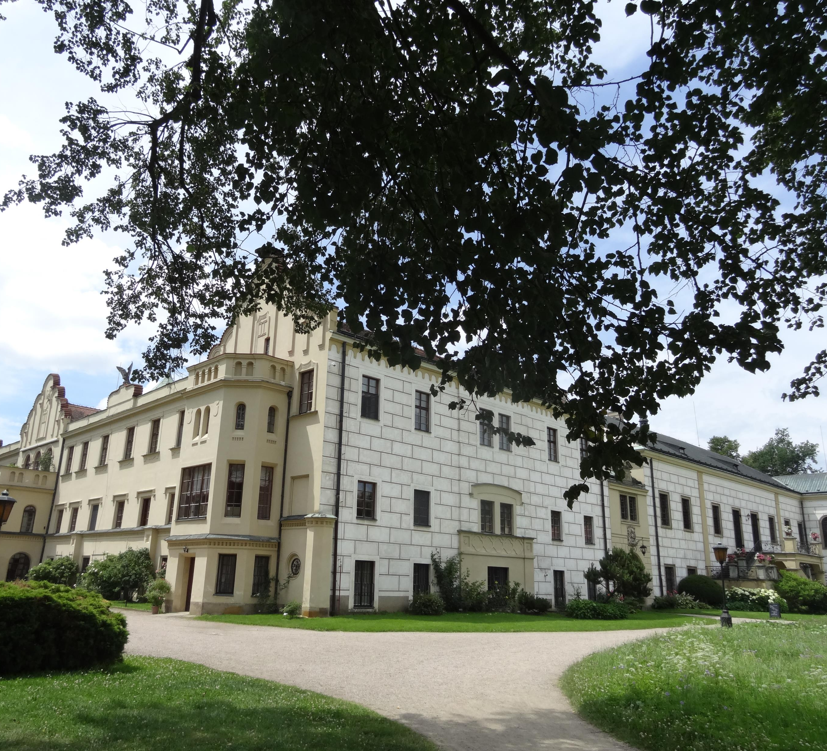
Castle Častolovice a renaissance-era castle
History of the Castle
It has been owned by the Sternbergs, a family of Czech nobles, for over 300 years. Its history dates back to the 13th century, when it was a fortress. During the 15th and 16th centuries the castle changed owners many times. The fortress was rebuilt into a Renaissance castle between the years 1588 and 1615. In the last half of the 19th century part of the castle was rebuilt in the then fashionable Neo-Gothic style and the English Park was designed and created.

Slide 5
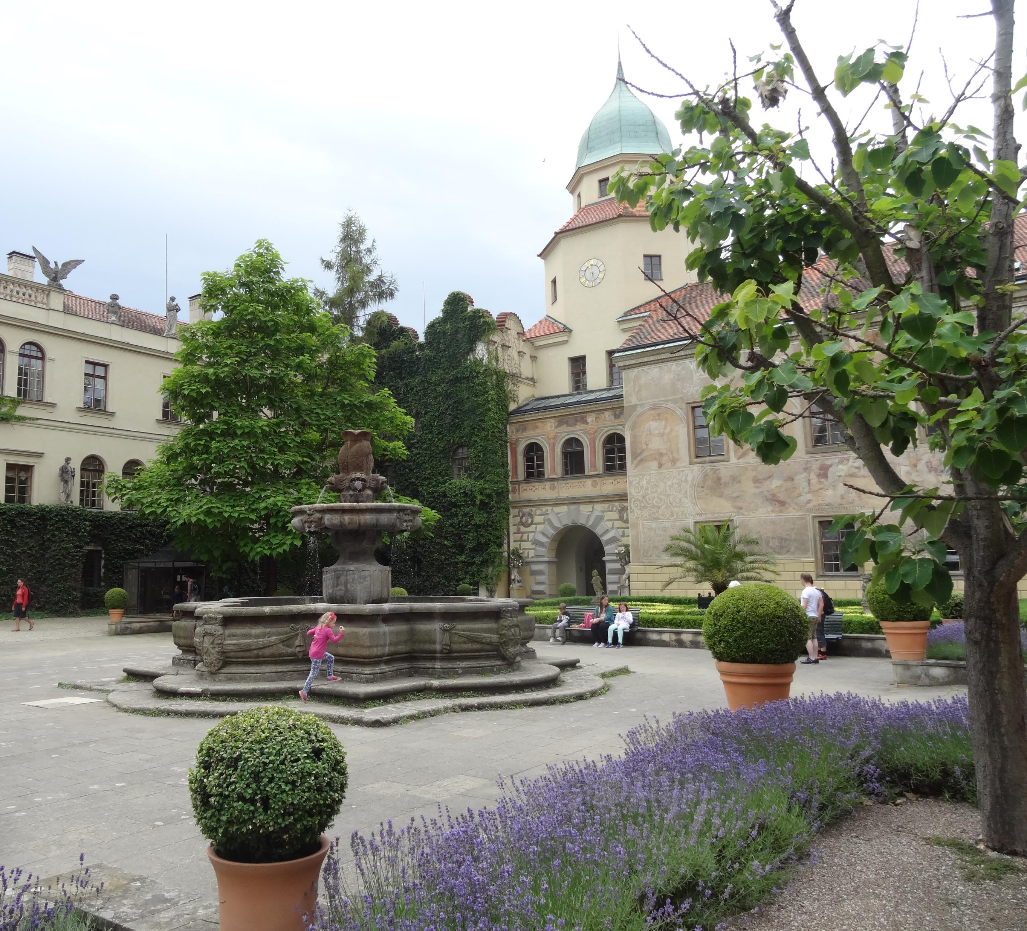
The owner of the castle, Diana Phipps Sternberg, a well known interior decorator, pays great attention to the presentation of the castle and park.
After restitution in 1992, it was evident that the courtyard frescoes would require repair. After a lot of research and planning, finally, in the year 2000 work began and today tourist can admire its beauty.

Slide 6
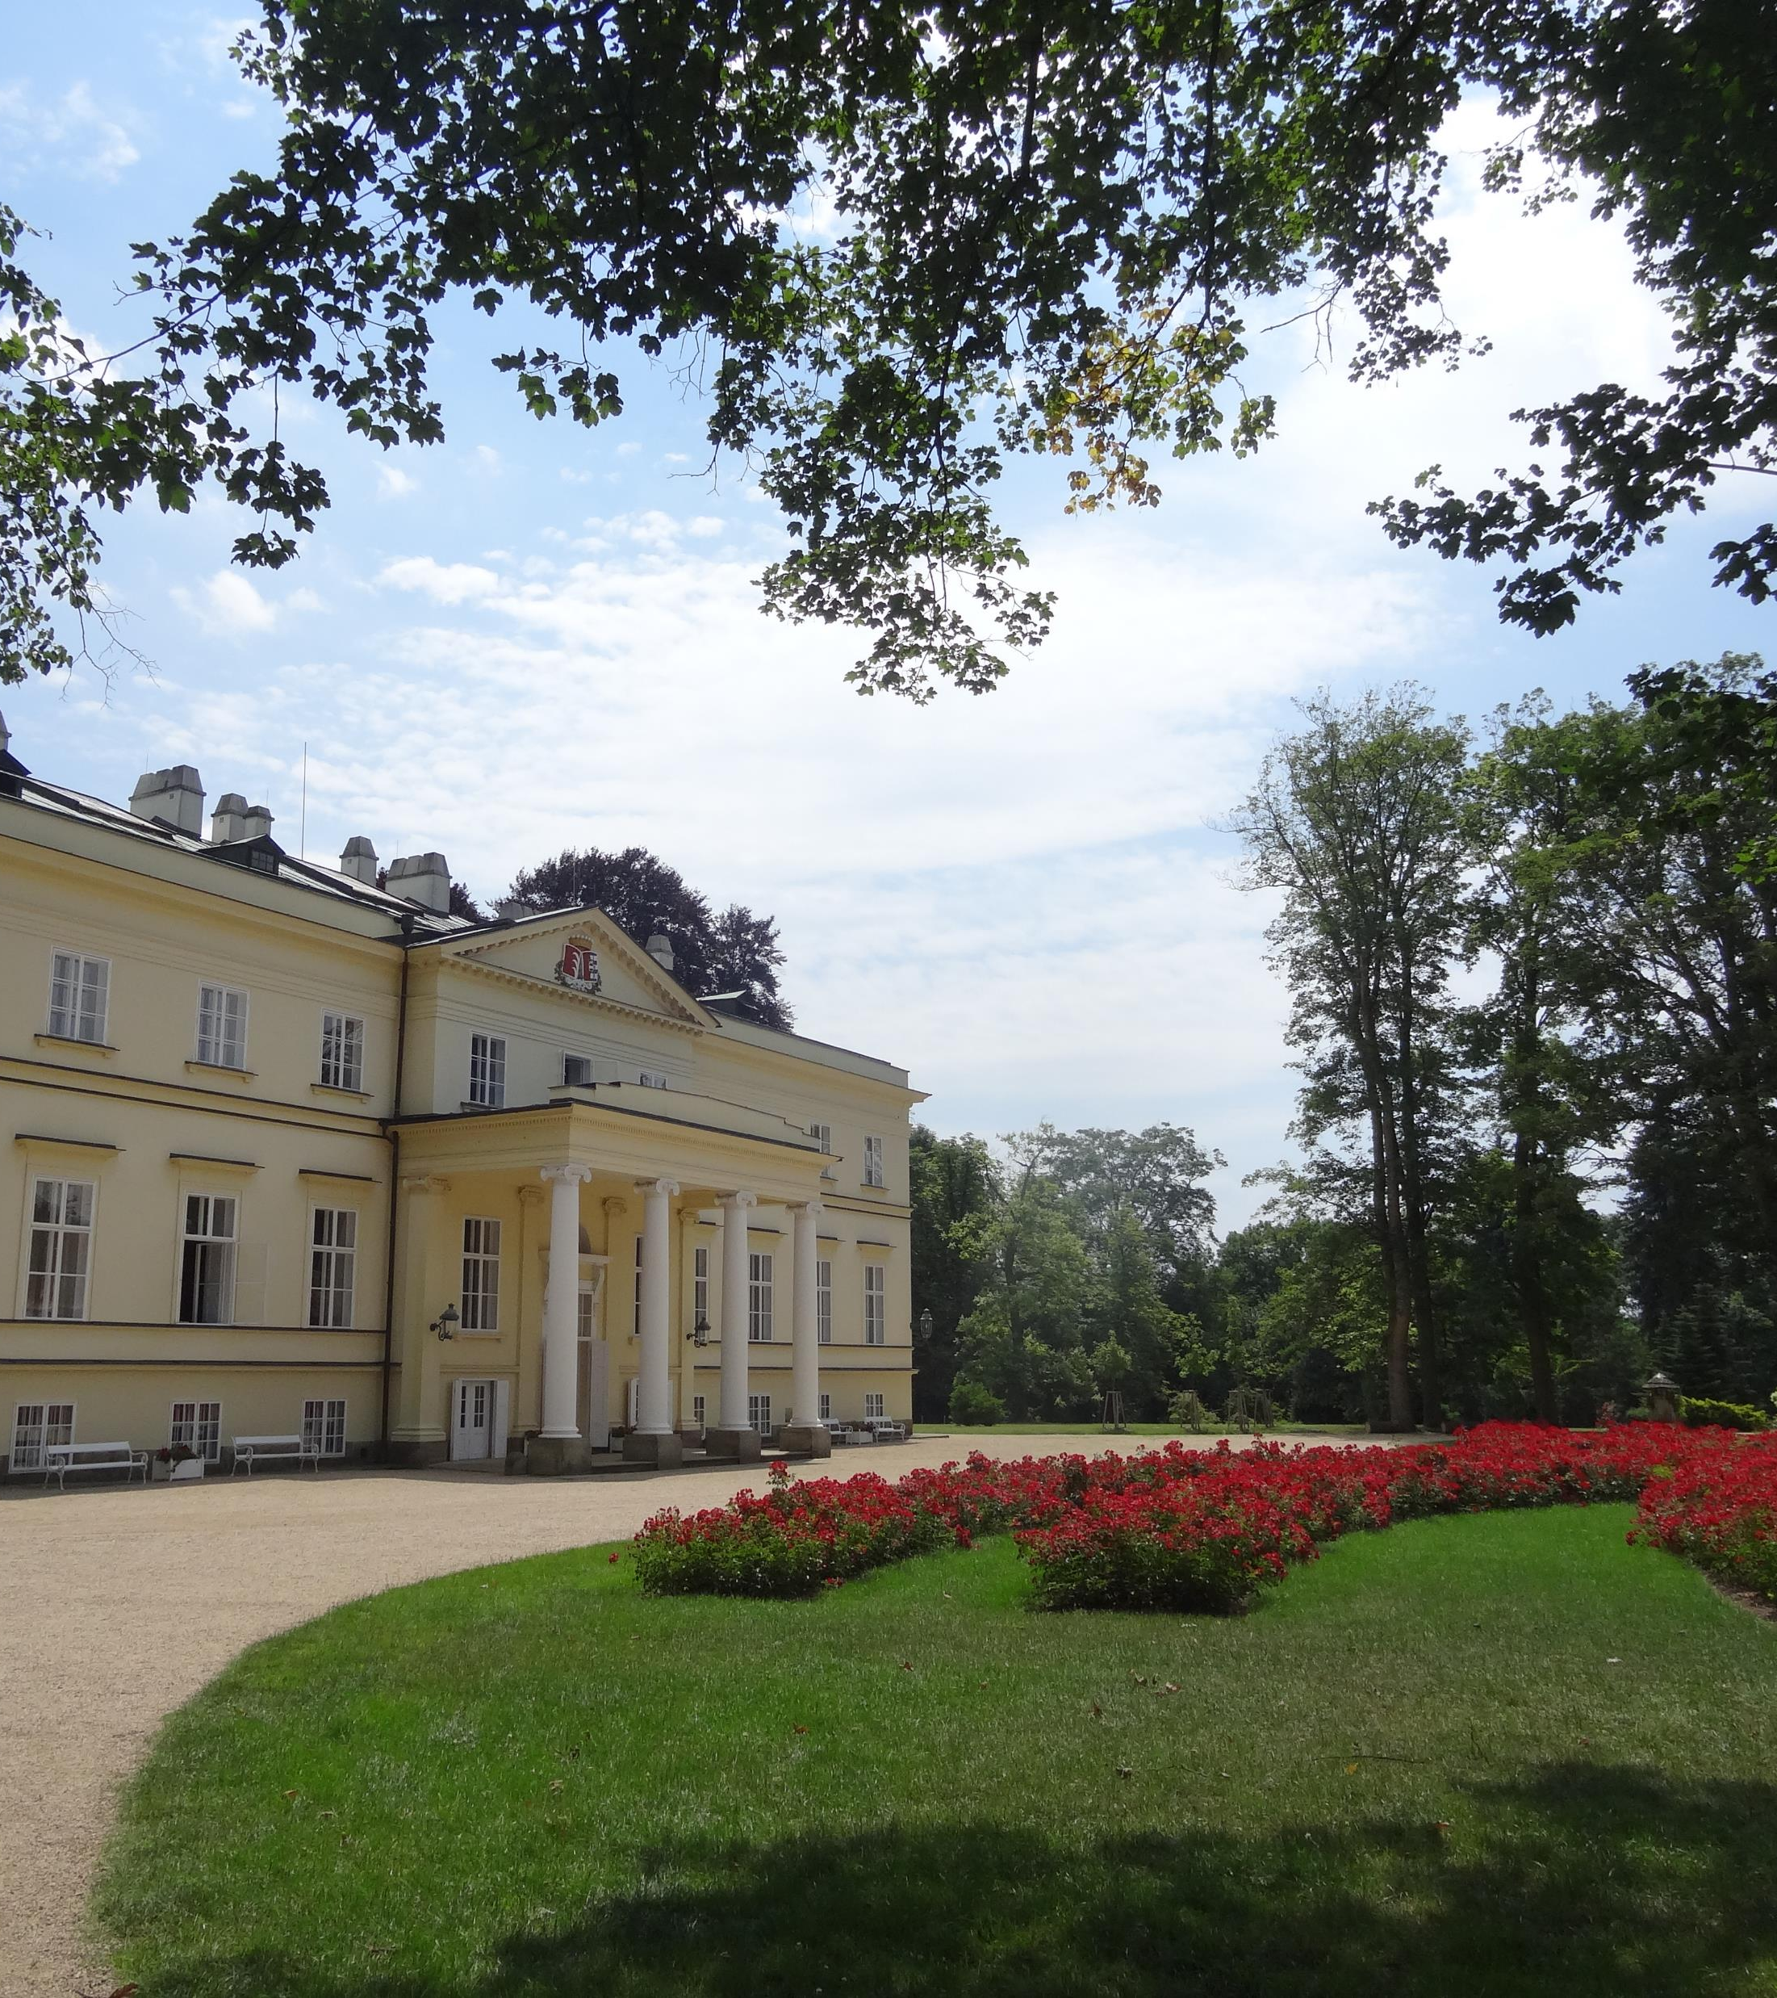
New chateau Kostelec nad Orlicí built in the style of Empire
History of the chateau
It was built between 1829 and 1833, now in property of the family of Kinský. There are expositions – Life in the biedermeir, Kinský Gallery and exposition of the history of Kostelec nad Orlicí.
A reception room and library were built on the elevated ground floor; the first floor contained residential spaces.

Slide 7
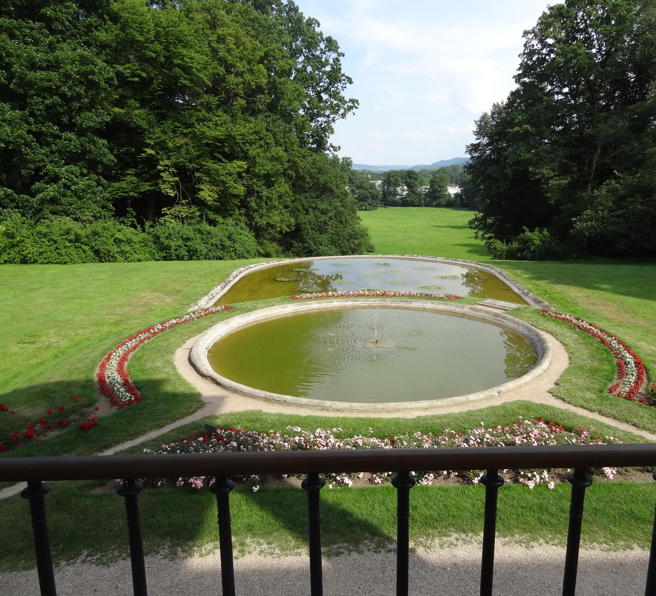
The chateau is surrounded by a large English park, which has now been declared a nature preserve.

Slide 8
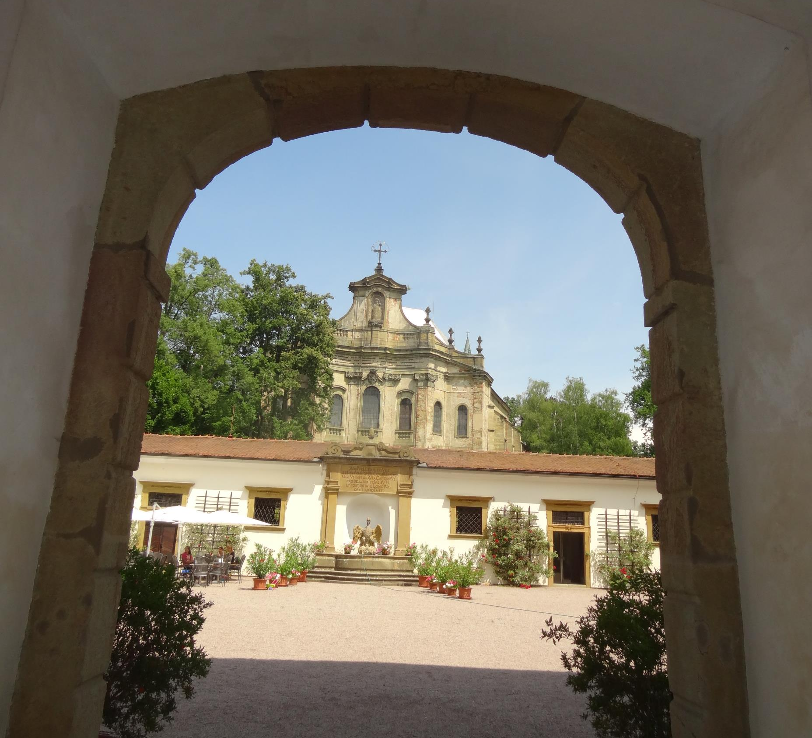
Chateau Rychnov nad Kněžnou An Early Baroque chateau
History of the chateau
chateau together with a baroque Holy Spirit church was built by Fr. Karel Kolowrat in 1676-1690. In 1722 the chateau was lengthened, widened, and raised, likely according to the design by a northern Italian architect Jan Santini Aichel.

Slide 9
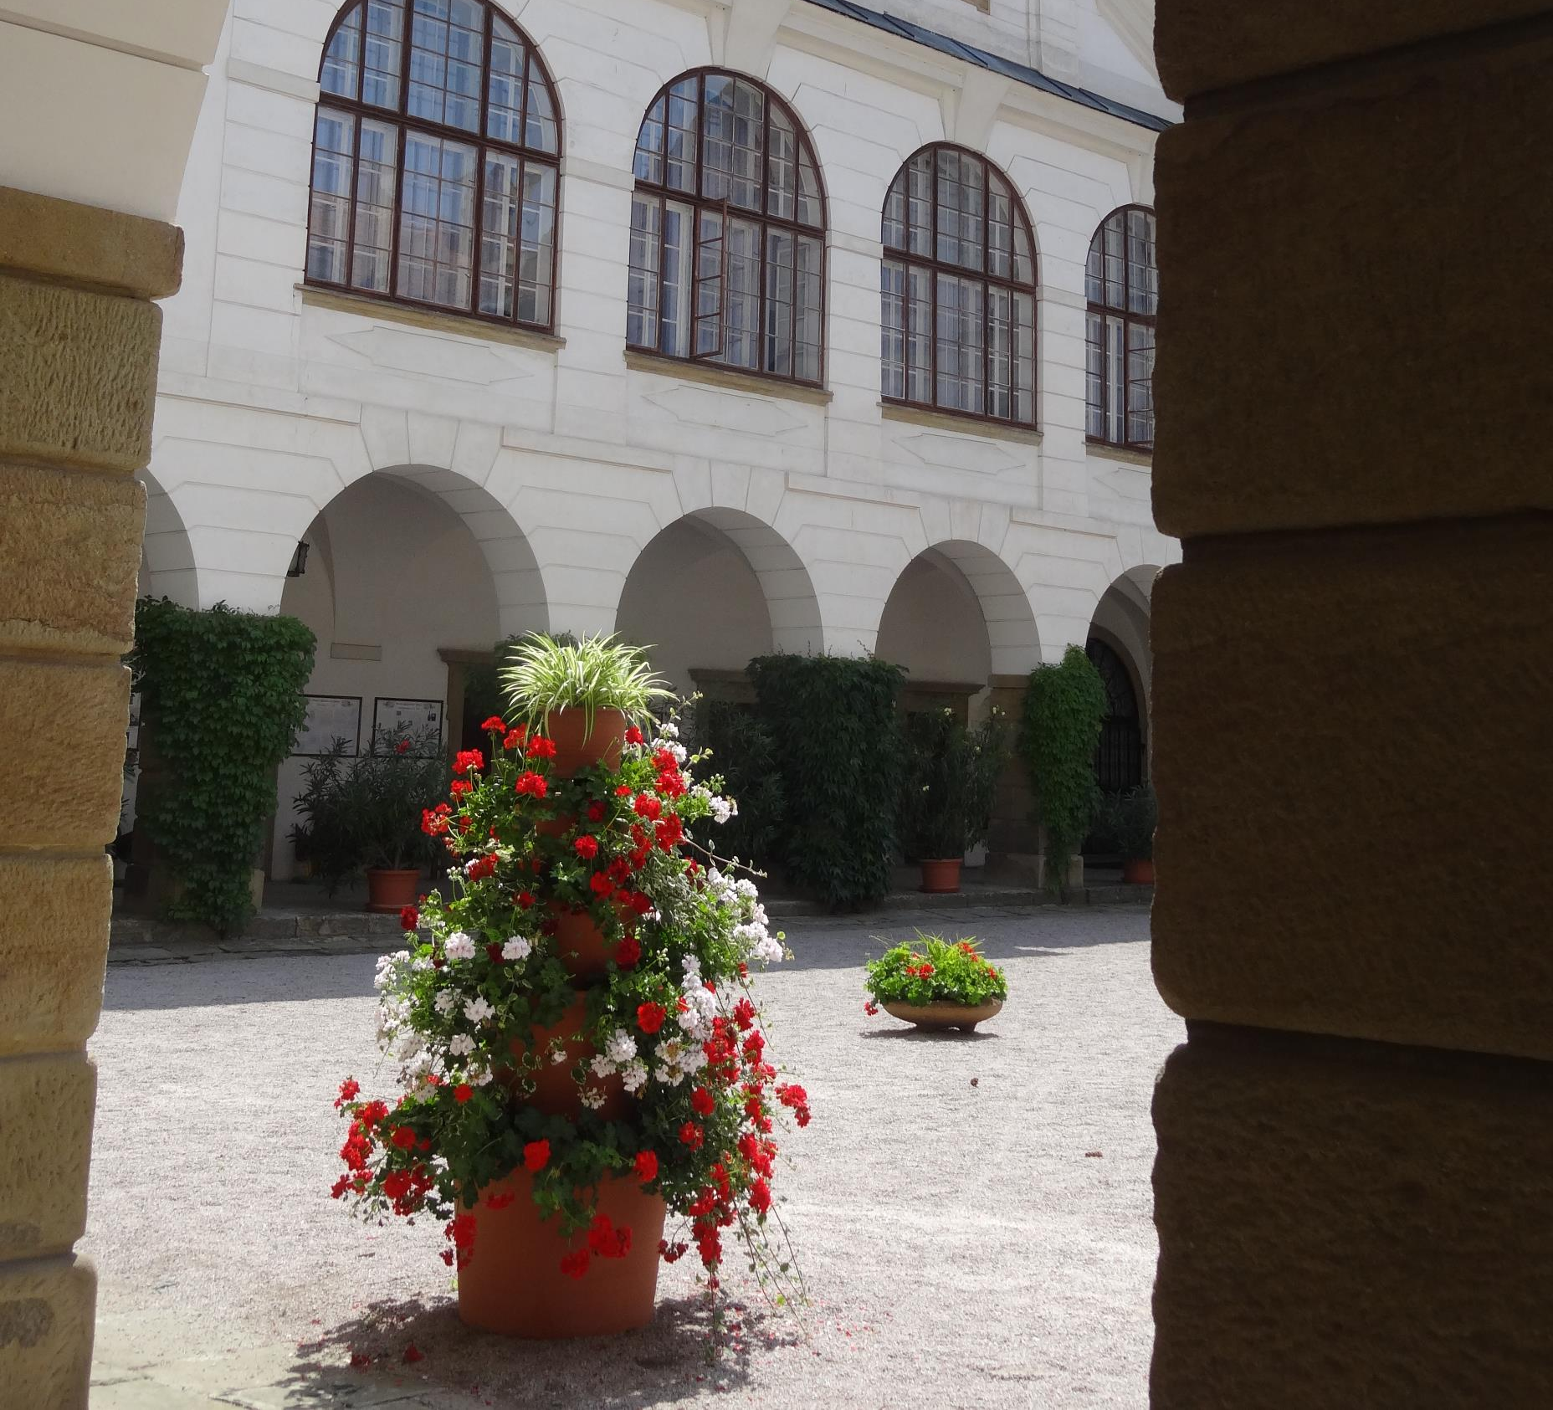
There are exhibits of Kolowrat Art gallery, Kolowrat crystal and a library of manuscripts. There is also a Museum and Gallery of the Orlické Mountains.
The collection of the Kolowrat family belongs to the biggest historical picture-galleries in our country.

