Slide 2
What do we mean when we say “real English”?
Notes:
Well..; We do NOT mean the opposite of “pretend English’ watch Catherine Tate

Slide 3
Notes:
AFTER THE VIDEO WORK IN PAIRS AND QUICKLY SAY WHAT YOU THINK REAL ENGLISH IS AND WHAT WORDS WOULD YOU USE TO DESCRIBE IT?

Slide 4
What do we mean when we say “real English”?
Idiomatic?
Notes:
Some possible answers: - THERE IS NO ONE RIGHT ANSWER. WE ARE EXPLORING POSSIBLE DEFINITIONS TOGETHER
Idiomatic involves what? Learning lists of idioms? Speaking idiomatically using collocations, phrasal verbs, latest expressions
Vernacular includes slang not good for exams or certain social situations Talk about the “Forgot me copy” incident
Natural natural to whom? Lots of English people naturally make mistakes and use slang
Standard English - who actually speaks it? Did ELT invent it? Well what if it did? English is the international language of business so it needs to be standardised but is it Real?
Who makes the standards? Talk about the Euro – do people respect the standards?
Communicative: any form of English that manages to convey a meaning?
All of the above???
Some info and anecdotes about BBC English
It is “real” but it has high standards is watched around the world and has influenced international English so SPEAKOUT very lucky

Slide 5
What do we mean when we say “real English”?
Idiomatic?
Don’t beat around the bush
That cost an arm and a leg
I would do it at the drop of a hat
Give me credit
Bromance
Bargainous
Buzzkill
Notes:
Some possible answers: - THERE IS NO ONE RIGHT ANSWER. WE ARE EXPLORING POSSIBLE DEFINITIONS TOGETHER
Idiomatic involves what? Learning lists of idioms? Speaking idiomatically using collocations, phrasal verbs, latest expressions
Vernacular includes slang not good for exams or certain social situations Talk about the “Forgot me copy” incident
Natural natural to whom? Lots of English people naturally make mistakes and use slang
Standard English - who actually speaks it? Did ELT invent it? Well what if it did? English is the international language of business so it needs to be standardised but is it Real?
Who makes the standards? Talk about the Euro – do people respect the standards?
Communicative: any form of English that manages to convey a meaning?
All of the above???
Some info and anecdotes about BBC English
It is “real” but it has high standards is watched around the world and has influenced international English so SPEAKOUT very lucky

Slide 6
What do we mean when we say “real English”?
Idiomatic?
Vernacular?
Natural?
Standard?
Communicative?
Queen’s English?
BBC English?
Notes:
Some possible answers: - THERE IS NO ONE RIGHT ANSWER. WE ARE EXPLORING POSSIBLE DEFINITIONS TOGETHER
Idiomatic involves what? Learning lists of idioms? Speaking idiomatically using collocations, phrasal verbs, latest expressions
Vernacular includes slang not good for exams or certain social situations Talk about the “Forgot me copy” incident
Natural natural to whom? Lots of English people naturally make mistakes and use slang
Standard English - who actually speaks it? Did ELT invent it? Well what if it did? English is the international language of business so it needs to be standardised but is it Real?
Who makes the standards? Talk about the Euro – do people respect the standards?
Communicative: any form of English that manages to convey a meaning?
All of the above???
Some info and anecdotes about BBC English
It is “real” but it has high standards is watched around the world and has influenced international English so SPEAKOUT very lucky

Slide 7
Topics we want to teach
Topics people want to talk about
Topics people need to talk about
Tools:
Grammar
Pronunication
Vocabulary
Notes:
Refer briefly to BBC logo
Not only provides stimulating and motivating topics that people really do want to and need to talk about but it also provides the tools you need to do so
Starting as it does with grammar, pronunciation and vocabulary sections as” lead in”
When I first picked up the intermediate level, right from unit one I got excited because these are topics you just want to teach.
Work extremely well with adults and also could work with older teens. Interesting and energising. Some examples……
Hand outs
Quizz, draw a bike

Slide 8
Notes:
HAVE YOU EVER SEEN HEARD OF THESE GUYS?

Slide 9
Notes:
These are of course presenters of the Top Gear programme.
(click) and this is of course the Stig – the man who never shows his face.

Slide 10
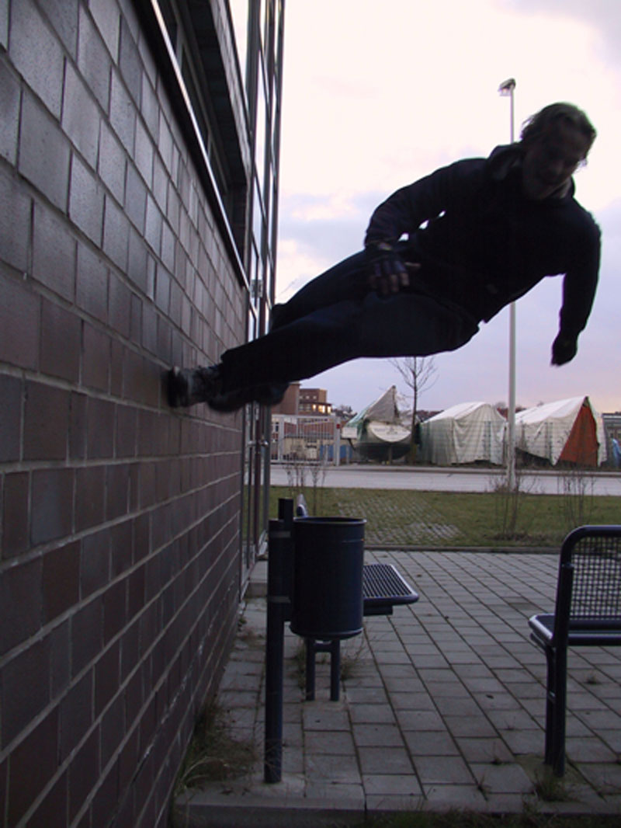
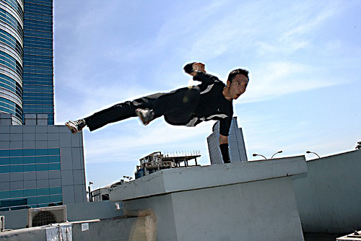
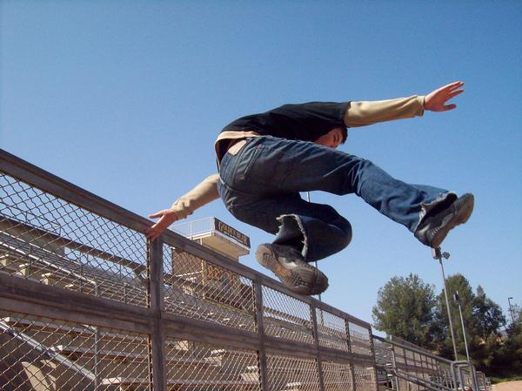
Notes:
Before we continue talking about cars and Top Gear, what do these pictures represent? parkour, a relatively new sport, which originated in France.

Slide 11
Notes:
So let's watch this little clip (an intro to an episode of Top Gear); as you watch it – what kind of race are they talking about?
It's a race between a car (Peugeot) and two men.
Who do you think will win the race? (elicit answers from the audience, or get them to raise hands who thinks the car will win vs who thinks the men will win).

Slide 12
Top Gear - the race explained
Top Gear - the race resolved
Notes:
Let's find out more about the race. We're going to watch another fragment of the Top Gear episode – your task: which city is it in (Liverpool), what is the starting point (edge of Liverpool), and what is the finish line (Liver building)
NB: click on "the race explained" to open a separate video file; the video finishes with a static picture to give you time to close the window before you go on with the presentation.
Now let's see if you were right about the winner of the race.
Click on "the race resolved" – again, it opens in a separate window and has a static picture at the end running for a couple of seconds.
Ok fab topics interesting videos but how do we get them speaking of they have a low level or lack confidence?
Not just interesting and exciting
Clear methodology and pedagogy

Slide 13
Top Gear - the race resolved
Notes:
Let's find out more about the race. We're going to watch another fragment of the Top Gear episode – your task: which city is it in (Liverpool), what is the starting point (edge of Liverpool), and what is the finish line (Liver building)
NB: click on "the race explained" to open a separate video file; the video finishes with a static picture to give you time to close the window before you go on with the presentation.
Now let's see if you were right about the winner of the race.
Click on "the race resolved" – again, it opens in a separate window and has a static picture at the end running for a couple of seconds.
Ok fab topics interesting videos but how do we get them speaking of they have a low level or lack confidence?
Not just interesting and exciting
Clear methodology and pedagogy

Slide 14
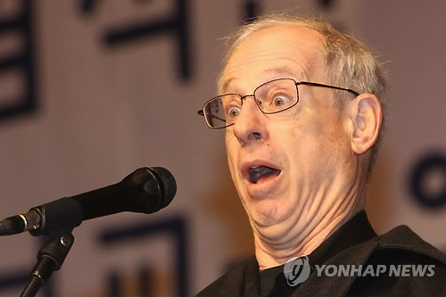
"Language acquisition does not require extensive use of conscious grammatical rules, and does not require tedious drill."

Slide 15
comprehensible input
Notes:
What Krashen is most famous for is (click) the comprehensible input hypothesis. Basically, without going into too much detail, he said that language learning can happen without any formal instruction – without taking part in a course, but by only being exposed to language which is just beyond our level, so we can still understand it, but it's a little difficult for us. Exposure comes in the form of (click) listening and (click) reading, of course.
Krashen claims that sufficient exposure will culminate in people starting to speak the foreign language they are exposed to after some time.

Slide 16
affective filter
Notes:
A very important part of Krashen's theory of language acquisition is (click) affective filter hypothesis, which is connected to emotions (click) . This states that learners' ability to acquire language is constrained if they are experiencing negative emotions. At such times the affective filter is said to be "up" and acquiring a language is much more difficult.

Slide 17
Notes:
Emotionally involved - motivated to learn more
What does this have to do with Top Gear?
Top Gear is something that fascinates people – (click) just google it and you'll see millions of results (click)...So, chances are that quite a few of your students will be interested in the topic, motivated by the topic and much more willing to take a risk with authentic materials because their affective filter will be considerably lowered.

Slide 18
Comprehensible input?
Notes:
Comprehensible input
Here's material from the coursebook which accompanies the dvd which we watched together.
First there is a section devoted to general understanding: here, students have to put the events from the video about the race in the right order.

Slide 19
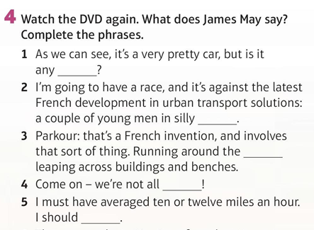
Notes:
We then go on to an activity focussing on detailed understanding where students have to fill in the gaps with some words to complete sentences.
OK, this is pretty standard stuff. So why am I getting so excited about this? Well, because I'm a fan of using authentic materials, especially videos in the classroom, and if this is what we do, we need to help students to cope with this kind of material and....

Slide 20
Notes:
make sure students don't get discouraged (click) Elementary level
or even .... (click) desperate.

Slide 21
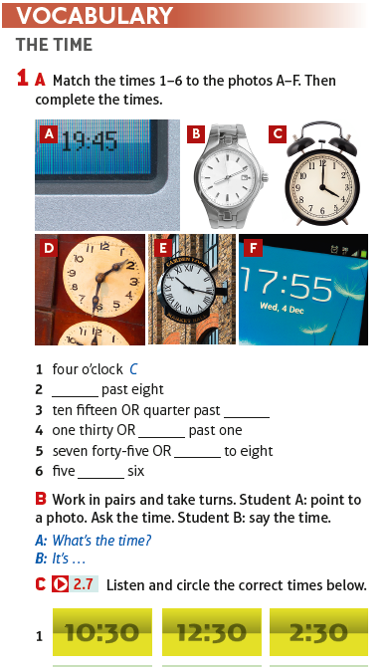
Priming in language teaching
Notes:
PRIMING lead in preparing etc I call it spoon feeding
In language teaching priming is a new word for something that as language teachers we have been doing since times immemorial: preparing students for receptive skills practice through pre-reading and pre-listening activities, as in this example from SO Elem 2nd ed.
(click) Do you recognise the city? – of course this is Golden Gate in San Francisco.
In the unit we have vocabulary work on (click) telling the time, (click) written information about SF tours, and all this prepares students to cope with a listening (click) which deals with booking a tour, and which then leads nicely into working on functional language – asking for information.

Slide 22
Notes:
And here we have a few situations which involve (click) misunderstandings and the students' task is (click) to decide what each situation is about.

Slide 23
Notes:
They then listen to check what the situations were.

Slide 24
Priming
Notes:
But before they do, there is language work going on: here, they need to join beginnings and endings of sentences and decide which ones deal with making arrangements. So, this is a clear element of priming – preparing students for the listening exercise which they will do in a moment.

Slide 25
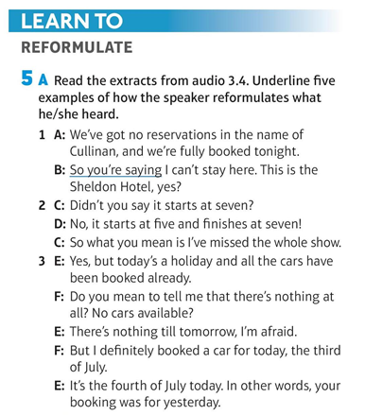
Noticing - shortcuts
Notes:
NOTICING
The next step, which is REALLY important in the development of speaking, is noticing – getting students to focus on specific language. Why is it important? If we want to follow Stephen Krashen to the dot, we could end up exposing ourselves to years of comprehensible input. We don't have that much time with our students, so we need to make certain shortcuts – we need to make them notice language so that they can then learn to use that particular language.

Slide 26
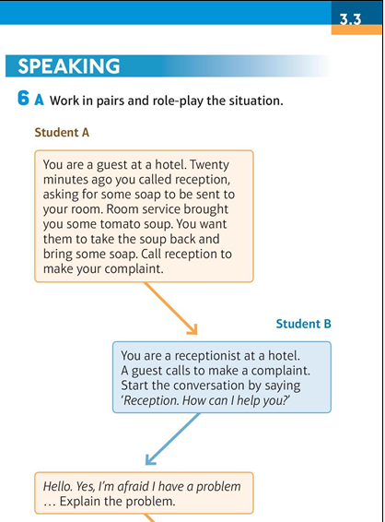
Notes:
This whole sequence leads to speaking – first very structured and controlled, and then much freer.

Slide 27
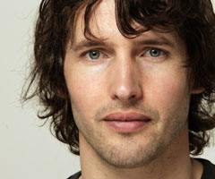
Using authentic videos with low-level students
material vs task
Notes:
Steve was talking about the importance of priming in the context of elementary learners when they are dealing with authentic or simulated authentic materials, which are bound to be difficult for them.
Yet we know that we need to provide as much exposure to real language as we can, in order to ensure sufficient comprehensible input for our learners, starting from the very early stages of learning. When using authentic materials, it's not the level of the material (click) that matters, but the level of the task.
Let's do an activity with an authentic video together.
(click) Can you recognise this man? (James Blunt, singer). Any song titles? ("You're beautiful")
We're going to watch a fragment of the official video to the song "You're beautiful". Your task: without taking any notes, try to remember what happens in the video moment by moment.
(click on the picture of James Blunt – this is a link to the video which opens in a separate window).
After watching let teachers compare very quickly in pairs.

Slide 28
Let's check!
Literal videos
Notes:
Shall we check? – click on the picture for a link to the literal version of this music video.
This is an example of a literal video – to see more, google "literal videos".

Slide 29
To understand enough...
Notes:
When we use authentic or simulated authentic materials with our students at low levels, it's important that students are helped to understand – not necessarily understand everything, but to understand enough so that they feel comfortable.
Now perhaps we can go back to Speakout 2nd edition and listen to what example Steve talks about. He's talking about a video from SO 2nd ed elementary which is a fragment of a BBC programme called "Tribal wives" (click for teachers to watch the intro to the programme – Steve's video is in the next slide)

Slide 30
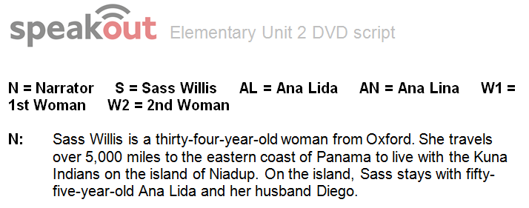

Slide 31
Footholds
Notes:
Another example of providing students with footholds is taken from the same BBC programme. Listen to Steve again (click on "Footholds" to play video which opens in a separate window)
Here is the fragment Steve talked about (click)

Slide 32
How does the brain work?
Notes:
When speaking our L1, how much do we create, how much do we re-create?
Research suggests that it's about 50-50 – which is bad news to all of us who think we are so unique :-)
The brain has a tendency to store whole "chunks" of language, ready to be used. It does not seem to make the difference between grammar and vocabulary; instead it classifies language it stores in terms of 3 spectra (go to the next slide)

Slide 33
Classifies according to three broad Spectra not grammar and vocabulary
useful for conveying meaning
not useful for conveying meaning
more generative
less generative
more generalisable
less generalisable
Notes:
We will look at examples in a moment.

Slide 34
useful for conveying meaning
not useful for conveying meaning
words, phrases, structures
which can be used in many
situations, e.g. "That's right"
can only be used to express one kind of meaning or can be used in one situation ("cough syrup")
more generative
less generative
of, get, on, do, have
present simple
neither do I
more generalisable
less generalisable
all language which has clear rules, e.g. formation of negatives, past simple regular
exceptions, one-off instances
of language

Slide 35
Size of the mental lexicon
Native speakers store a huge number of lexical items:
single words
collocations
fixed phrases
whole sentences.
Estimates vary considerably, but are never less than tens of thousands.
Active and passive lexical items together: the number probably runs into hundreds of thousands.
Notes:
How big is a native speaker’s lexical repertoire?
Native speakers store a huge number of items of all lexical categories : from single words to collocations to institutionalized expressions. How many exactly?
Estimates vary considerably, but are never less than tens of thousands. If we consider both active and passive lexical items, the number probably runs into hundreds of thousands.

Slide 36
Where does communicative power come from?
From storing huge amounts of lexical items, from single words to whole sentences, in our brains.
‘I don’t know.’
Notes:
NB: the last 3 slides (including this one) seem self-explanatory; the only comment I have is about "I don't know":
This is a perfect example of how we store chunks of language. When did you learn this phrase? You probably don't even remember, because you've always known it. When we analyse the grammar of "I dont' know", it's present simple negation, first person singular, verb of cognition. But when we learnt it, we never analysed it, we just accepted the whole phrase just as we accept single words.

Slide 37
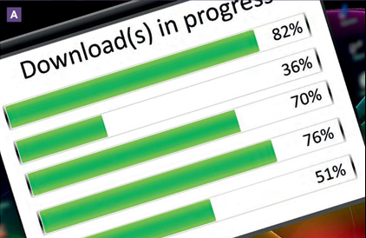
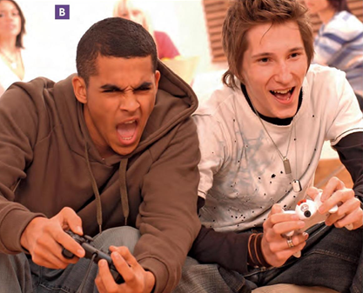
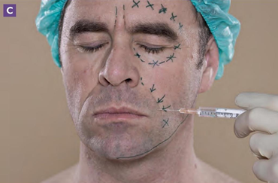
Notes:
Let's look at how this communicative power is developed in SO.
First of all, (click) students have to decide what these pictures represent.
They are then presented with newspaper clippings (click) and have to match these to the 3 pictures (click for matches)

Slide 38
Concentrate on functions
Notes:
The next step is listening to conversations where people agree or disagree with the opinions expressed in the newspaper clippings – this is listening for general understanding,
Then we go on to listening for detailed understanding – students have to fill in gaps in functional phrases (and the important thing is that they focus on whole phrases – because this is what provides students with communicative power).

Slide 39
Notes:
Then we add more phrases (click) to the ones which have been focussed on in the listening
and finally – there is a reference to language bank (click) where all this language is organised in a very clear way.

Slide 40
Notes:
And then we move to structured (click) and finally to freer (click) speaking using these phrases which have been focussed on.

Slide 41
Expose students to comprehensible authentic listening and reading materials
Prepare them through priming
Take “shortcuts” by focussing on set phrases to memorise
Build on structured controlled speaking drills and then…
…Provide interesting free speaking role plays and discussions
It only works if………..
The material is interesting, engaging and REAL

Slide 42
Thank you

