Slide 1
The 25th P.A.R.K. Conference
‘But what’s the point?’
Motivation in the secondary classroom
Amanda Davies
Mendel University, Brno, 9 November 2019

Slide 2
Session menu
Image by Nathalie Lees
1 What is motivation?
2 The importance of mindset
3 Classroom strategies to increase motivation

Slide 3
What is motivation?
‘Motivation is what causes you to act, whether it is getting a glass of water to reduce thirst or reading a book to gain knowledge’.
Retrieved from https://www.verywellmind.com/what-is-motivation-2795378 28/10/19

Slide 4
What is motivation?
Intrinsic motivation: internal forces that cause someone to do something, such as personal satisfaction.
Extrinsic motivation: external forces that cause someone to do something, such as rewards.

Slide 5
Extrinsic and intrinsic motivation
I did the exercise because:
the teacher promised us a game
I wanted the teacher to praise me
It was really interesting
I wanted to get a prize
I want to speak English with confidence
I didn’t want the teacher to punish me
I enjoy everything we do in lessons
I need to improve my grades so I can move up next semester
I need to pass an exam to get into university
I’m going to the UK soon and I want to be able to communicate
I feel good when I try my best

Slide 6
Extrinsic and intrinsic motivation
I did the exercise because:
the teacher promised us a game
I wanted the teacher to praise me
It was really interesting
I wanted to get a prize
I want to speak English with confidence
I didn’t want the teacher to punish me
I enjoy everything we do in lessons
I need to improve my grades so I can move up next semester
I need to pass an exam to get into university
I’m going to the UK soon and I want to be able to communicate
I feel good when I try my best

Slide 7
Components of motivation
Image by Tang Yau Hoong
1. Direction – The goal that makes us act
2. Intensity – The amount of effort we put in
3. Persistence – The duration of our efforts

Slide 8
Carol Dweck’s theories of motivation
Image by Davide Bonnazi
Think of a student you have taught who lacked motivation.
How did you know they lacked motivation?
Now think of a highly motivated student.
How did you know they were motivated?

Slide 9
Fixed vs Growth mindset
People with a fixed mindset:
believe that intelligence and ability are fixed.
avoid challenges
give up easily
see feedback as criticism
feel threatened by the success of others
People with a growth mindset:
believe that intelligence and ability can be developed.
embrace challenges
don’t give up easily
see feedback as a way to improve
are inspired by the success of others

Slide 10
Developing a growth mindset
We can promote growth by ensuring our classrooms are places where…
students take responsibility for their own learning
students are aware of their own learning
mistakes and failure are used as learning opportunities
students can take risks
effort is valued
feedback supports learning
students are challenged

Slide 11
1. Help students take responsibility for their learning

Slide 12
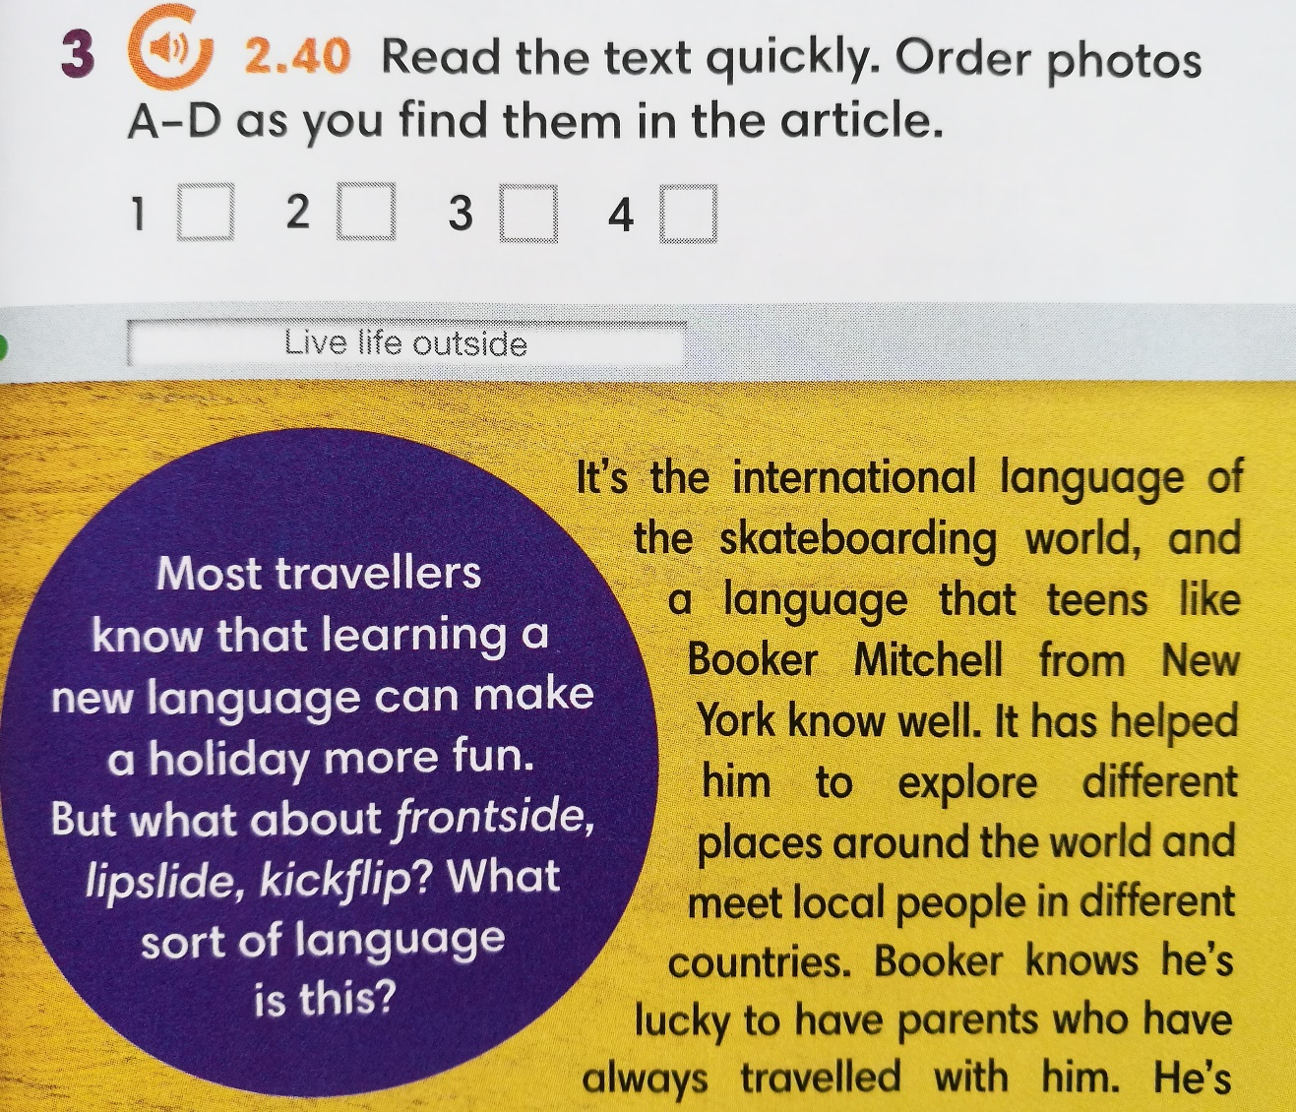
Choice boards
Do all the tasks in any order:
Read the text on p.73 and do exercise 3. | Check your homework – ask the teacher for the answer key.
Choose 3 words in the text on p.73 and check the meaning in an online dictionary | Re-read the grammar box on p.72

Slide 13
Choice boards
Choose 1 task here | Make flashcards for the new vocabulary. Draw a picture on one side and write the word on the other side. | Make a word search. Include all the new vocabulary from the lesson. | Write a sentence for each new word from the lesson.

Slide 14
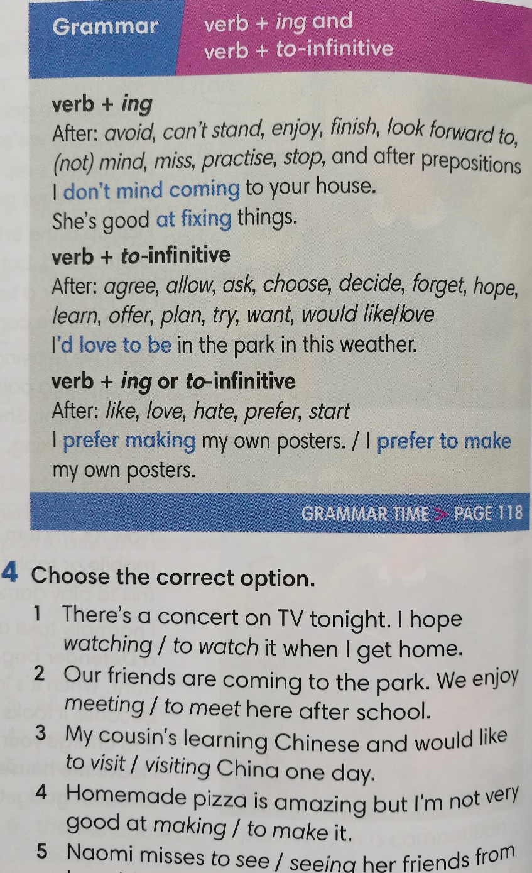
Choice boards
Do ex 4 on p.14. Then choose 1 task here. | Make a ‘fill the gaps’ task using the verbs in the grammar box. Write 5 sentences. | Write 5 sentences using the verbs in the grammar box. | Write 5 questions using the verbs in the grammar box. Ask a friend your questions.

Slide 15
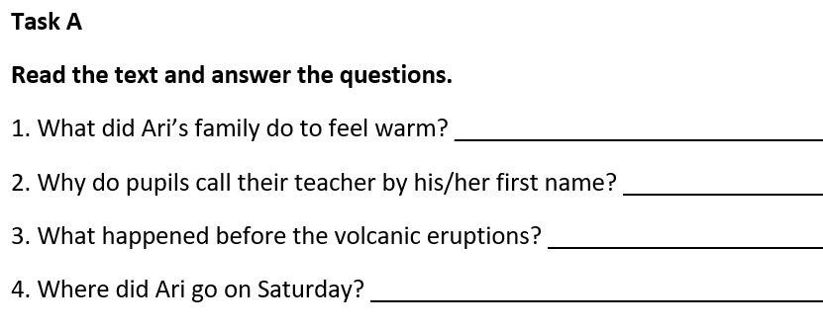
Choice boards – differentiated tasks
Read the text on p.25. Choose 1 task. | Task A – write the answers | Task B – write the questions | Task C – write the questions and the answers

Slide 16
Choice boards – differentiated tasks
Read the text on p.25. Choose 1 task. | Task A – write the answers | Task B – write the questions | Task C – write the questions and the answers

Slide 17
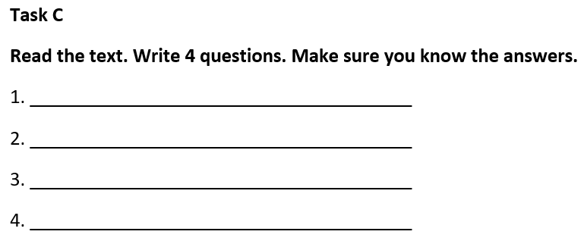
Choice boards – differentiated tasks
Read the text on p.25. Choose 1 task. | Task A – write the answers | Task B – write the questions | Task C – write the questions and the answers

Slide 18
Project ideas: Making the world a better place
Research local charities and choose one. Make a poster and arrange a class donation.
Design an outfit from recycled materials and showcase it to your classmates.
Find out about some mindfulness techniques. Teach one to your classmates.
Is it safe to drink tap water in your city? Find out and make a poster to tell your classmates what you discovered.
Invent an app or game that teaches children how to look after the planet. Present your idea to your classmates.
Research recycling rules in your city and make a checklist for your classroom.
Calculate your ecological footprint and plan how to reduce it. Share your ideas with your classmates and encourage them to join you.

Slide 19
2. Involve students in the learning process

Slide 20
Make learning visible
I can describe the differences in customs between two cultures.
Apart from your own culture, which cultures are you familiar with? Share your knowledge with your group.
Will you need to do some research? If so, when was the last time you carried out research? What worked well? What didn’t work so well? Share some advice with your group.
What structures or vocabulary can you use to compare things?

Slide 21
Make learning visible
Lesson aims:
I can name 10 endangered animals.
I can identify the features of a paragraph.
I can write a paragraph giving my opinion about zoos.
What’s an endangered animal? How many endangered animals can you name?
What are some common features of a paragraph? Do you know what a topic sentence is?
When did you last write a paragraph in English? What things did you find difficult? What did you do well?

Slide 22
Make learning visible
Lesson aims:
I can name 10 endangered animals.
I can identify the features of a paragraph.
I can write a paragraph giving my opinion about zoos.
What new words did you learn today?
What are the common features of a paragraph? What makes a good topic sentence?
Are you happy with your paragraph? What are you going to focus on next time we do writing in class?

Slide 23
Self-reflection
Reflective questions:
What’s the most important thing I learnt?
What was my most challenging moment?
How well did I communicate with my partner?
What would I do differently if I repeated this task?
Sentence stems:
I enjoyed… because…
I managed to…
I found it difficult to… because…
I found it easy to… because…
I need more help to…
I’d like to find out…
I’d like to practice…
3-2-1 Exit card Name______________
3 things I learnt today…
2 things I found interesting…
1 question I still have…

Slide 24
3. Give formative feedback

Slide 25
Formative feedback
‘Feedback can have a positive or negative impact on pupils’ learning. Good quality feedback can significantly raise both pupils’ self-esteem and their performance. The way they feel about themselves as learners is learned, and teachers need to be aware of the powerful messages they may be sending through feedback, whether verbal, non-verbal or written. Effective feedback is specific to the pupil (rather than comparative) and is descriptive (rather than evaluative). The first thing a pupil should do when given feedback is to think, not react emotionally.’
Assessment for Learning A Practical Guide, CCEA, 2019 , p29

Slide 26
Formative feedback
Excellent speaking, you only used English. Well done.
I enjoyed listening to your discussion. You made a good point about the importance of eating healthy food. Did you use any of the words from the lesson? Can you use some of them now?
Your article is very well balanced and interesting to read. To improve your work include some of the linkers from p43. Find 4 places where you can use one to organise your ideas.
Please develop this idea further.
You wrote an interesting introduction, but you must try harder to finish your work.

Slide 27
Formative feedback
You used a good variety of structures. Look again at the verb forms, and decide if you need to make any changes.
What else did you do on your holiday? Tell me 2 or 3 more things.
I liked it when you used adjectives to describe your friend’s appearance. Can you tell me something about your friend’s personality? Is she patient, reliable?
Well done everyone, excellent work today.
I’m interested in the ways you help the environment. Can you tell me what you do (recycling, turning lights out, saving water)?

Slide 28
Formative feedback
I enjoyed listening to your discussion. You made a good point about the importance of eating healthy food. Did you use any of the words from the lesson? Can you use some of them now?
Your article is very well balanced and interesting to read. To improve your work include some of the linkers from p43. Find 4 places where you can use one to organise your ideas.
You used a good variety of structures. Look again at the verb forms, and decide if you need to make any changes.
I liked it when you used adjectives to describe your friend’s appearance. Can you tell me something about your friend’s personality? Is she patient, reliable?
I’m interested in the ways you help the environment. Can you tell me what you do (recycling, turning lights out, saving water)?

Slide 29
Success criteria
Find someone who…
has been to Italy
has won a competition
hasn’t been to the dentist this year
has read all the Harry Potter books in English
hasn’t finished all their homework
has celebrated their birthday recently
I will be successful if I… ask questions using the present perfect ask follow up questions using the past simple show interest in my classmates speak to at least 5 different people

Slide 30
Success criteria
Task: Write an adventure story.
I will be successful if…
people enjoy reading my story
my story has a beginning, a middle and an ending
I use interesting adjectives to describe my characters and their surroundings
I write 180-200 words

Slide 31
Success criteria
Success criteria: Read the text quickly to get a general understanding Read the text more carefully and look for the answers Underline your answers in the text Try to guess the meaning of new words

Slide 32
Final thoughts
Image by Ruben Alvarado
Give choices – choice boards, differentiated tasks
Make learning visible – learning objectives, self – reflection, exit cards
Establish success criteria
Give formative feedback

Slide 33
Final thoughts
Motivation is hard to identify.
Being prepared and on time for a lesson offers no clue to motivation.
Looking bored or disinterested doesn’t mean you are unmotivated.
People naturally seek tasks that they enjoy and avoid tasks they don’t like.

