Slide 1
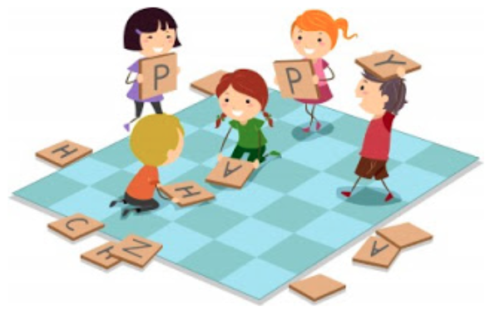
TheTheory of Multiple Intelligences
by Mgr. Zuzana Pohlová
Notes:
Neologism

Slide 2
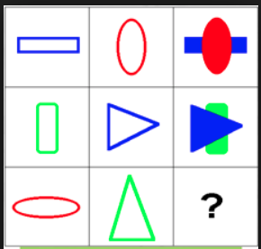



INTELLIGENCE
IQ TESTS
INTELLECTUAL POTENTIAL
CAN BE MEASURED
DIFFICULT TO CHANGE
a)
b)
c)

Slide 3
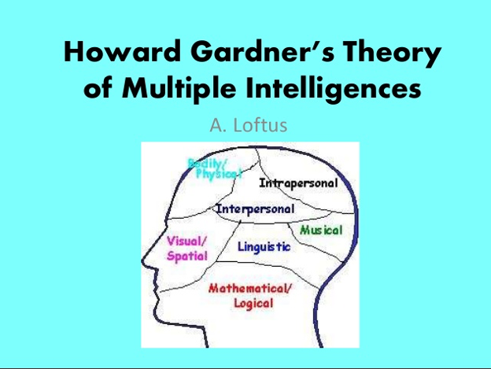

Slide 4
Howard Gardner´s Theory of Multiple Intelligences
INTELLIGENCE = A SET OF ABILITIES, TALENTS AND MENTAL SKILLS
WE ARE ALL SMART
STUDENTS LEARN BEST WHEN ENGAGED IN ACTIVITIES THAT TAKE ADVANTAGE OF THEIR STRENGTHS

Slide 5
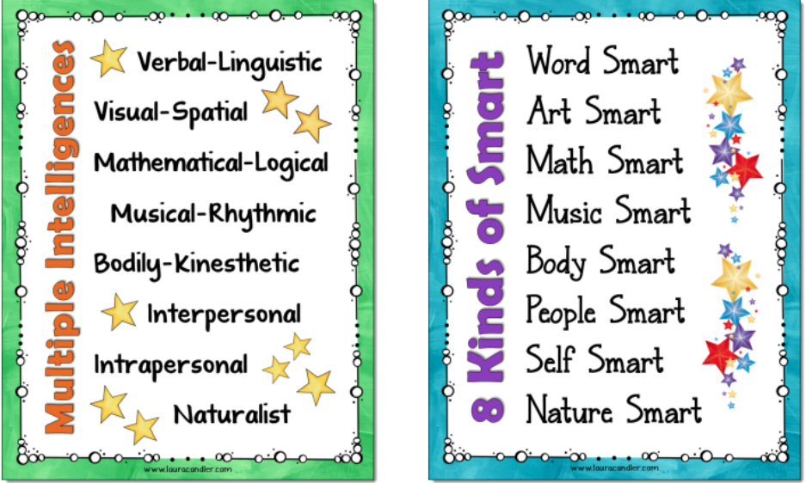
www.lauracandler.com

Slide 6
WORD SMART | LOGIC SMART | PICTURE SMART | BODY SMART
Word games Reading games Writing games Storytelling Show and tell Role-play | Word puzzles Reading puzzles Logical problem solving Error recognition Grammar categorizing activities Brain teasers | Shape puzzles Mind maps Drawing Visualizations Diagrams Drawing Videos Flashcards, photos | TPR Craftwork Dancing Physical activities Action rhymes, songs, games
MUSIC SMART | PEOPLE SMART | SELF SMART | NATURE SMART
Songs Action rhymes Chants Reading out loud | Pair work Group work Brainstorming Peer teaching Dialogues Interviews surveys | Learning diaries Creative writing Project work Personal goal- setting Sharing personal experience | Patterns Classifying Sorting Nature projects Animal and plant life

Slide 7


FLASHCARDS
GREAT RESOURCE FOR ESL KIDS LESSON
CHILDREN – VISUAL LEARNERS
LOTS OF VOCABULARY RELATED GAMES
WORD SMART
PICTURE SMART
BODY SMART
PEOPLE SMART
SELF SMART
LOGIC SMART
MUSIC SMART
NATURE SMART

Slide 8
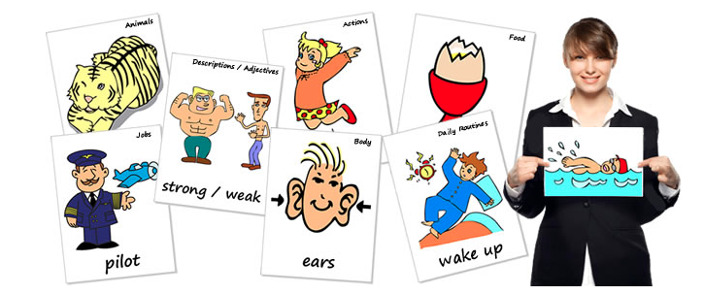
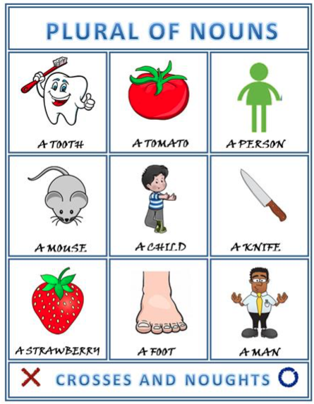
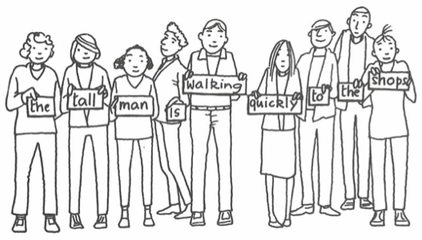
DRILLING/ CIRCLE DRILLING
DRAWING
NOUGHTS AND CROSSES
SORTING
MIMING
THE TELEPHONE GAME
FLASHCARDS SENTENCES

Slide 9
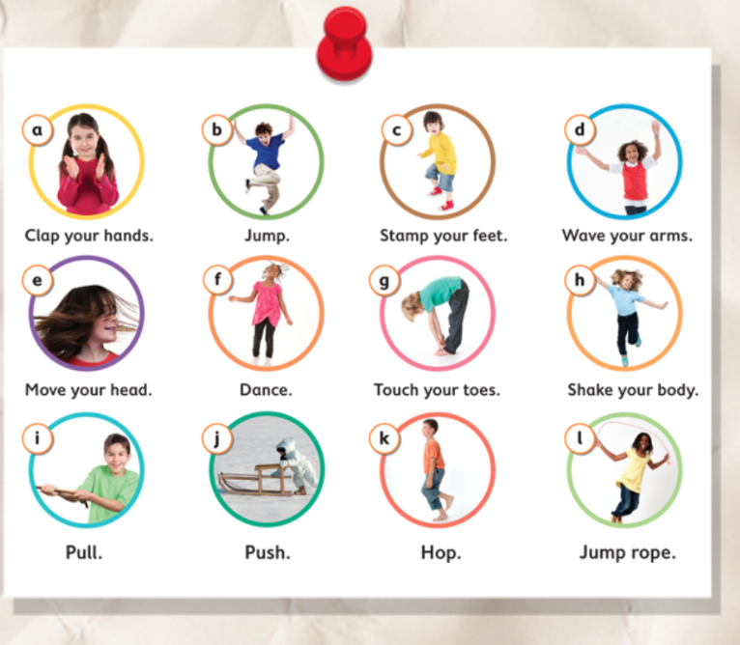

BODY SMART
CHOOSE
YOUR
ACTIONS
AND TURN
THEM INTO
AN
EXERCISE ROUTINE
INPUT LANGUAGE
I want ………..
…………. first/next/last.
Notes:
Typical body smart activity but if play music while doing the actions, it will be perfect for music smart learners as well.

Slide 10
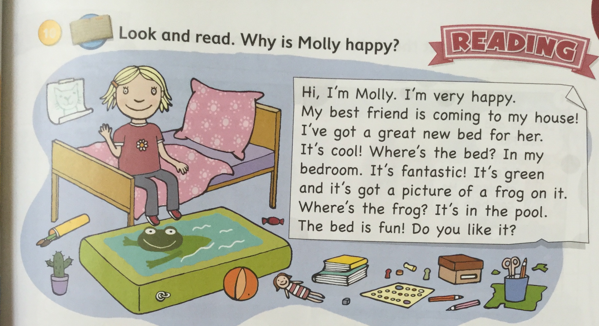

Slide 11
MORE PRACTICE
WORD SMART
READ AND CIRCLE.
1. Molly is (happy / hungry).
2. She’s got a new (book / bed).
3. It’s got a picture of a (snake / frog) on it.
PUPILS WRITE MORE SENTENCES WITH TWO OPTIONS

Slide 12
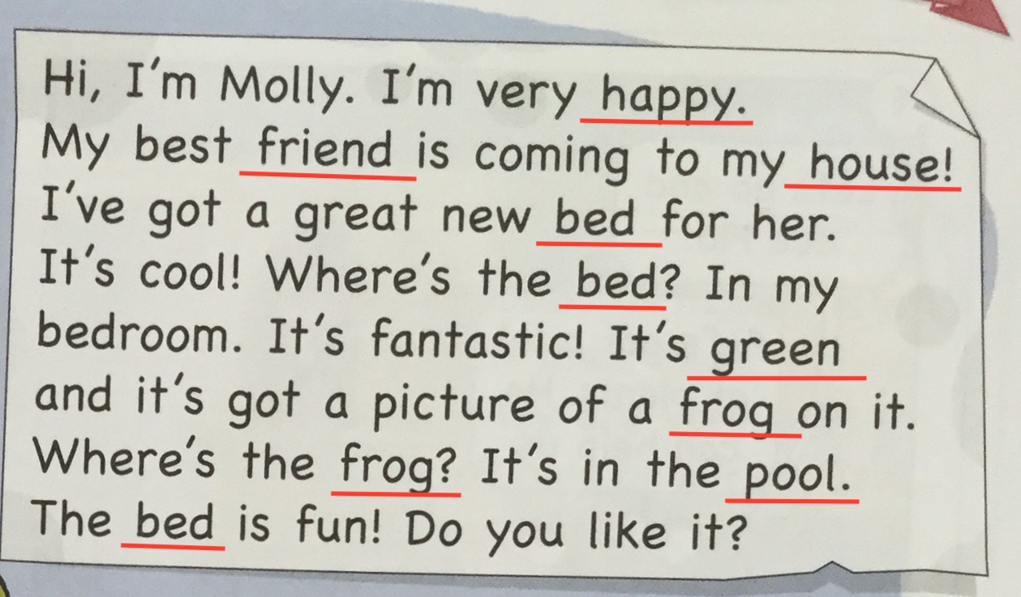
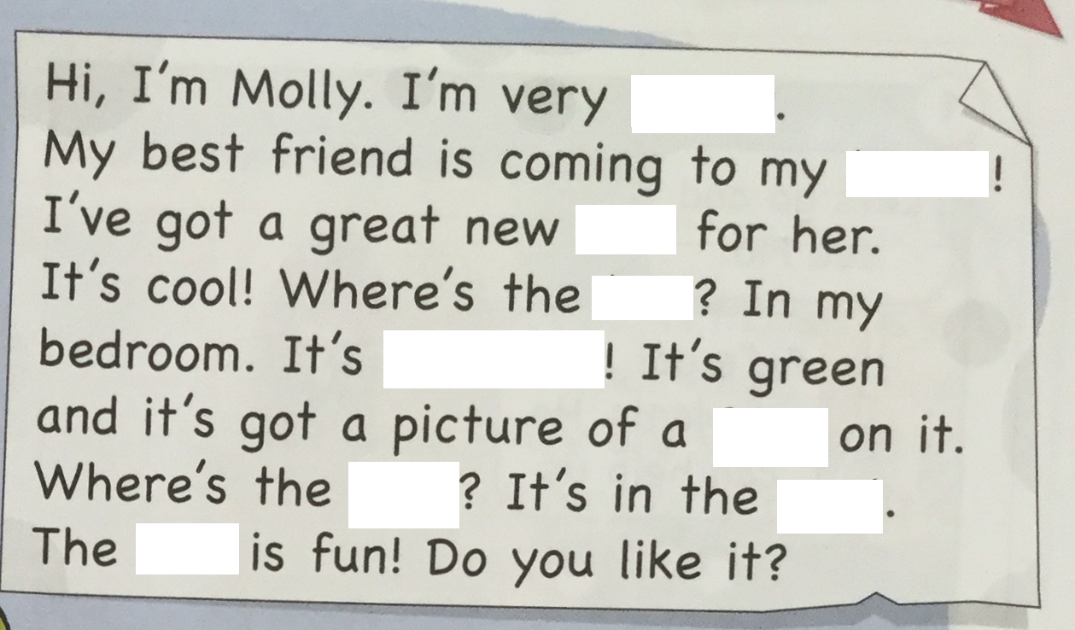
Underline some words
Delete the words

Slide 13
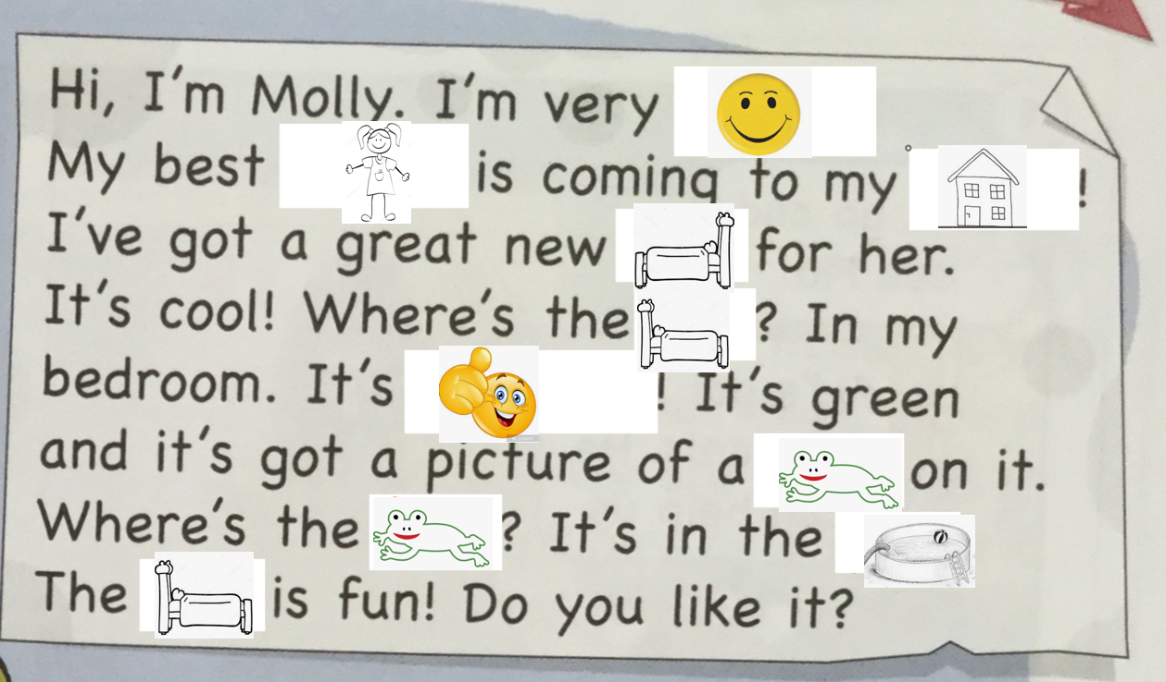
Ask the pupils to draw pictures
The pupils
read the text
again
Notes:
They can do it with one partner or more partners to get more practice. You could ask them to move around the classroom and change partners.

Slide 14
Do you remember?
What about your bed/room?
Notes:
You could check how much they remember. Ask them to write about Molly´s bed. Thus they will have to produce some language, this way they will become more confident users of English.

Slide 15
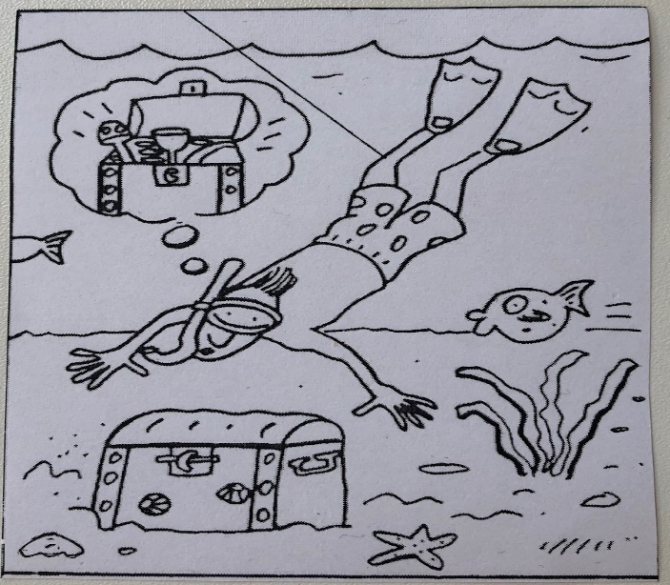
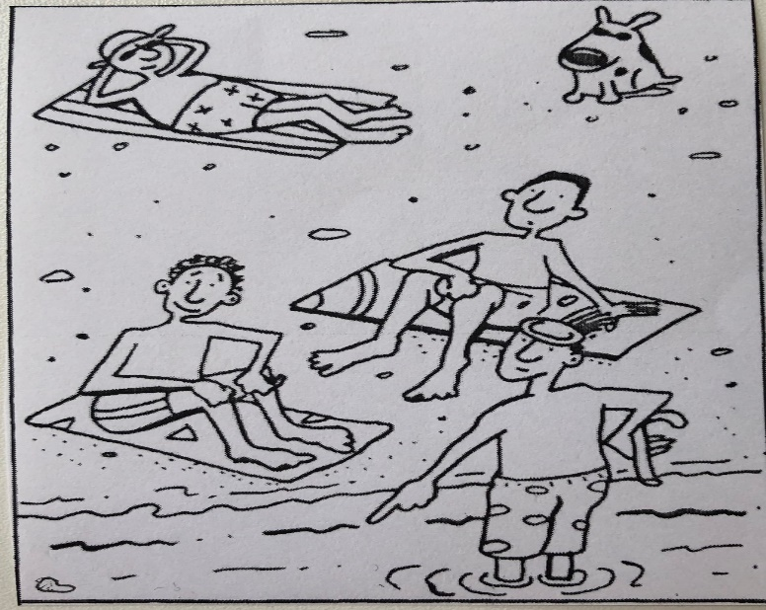
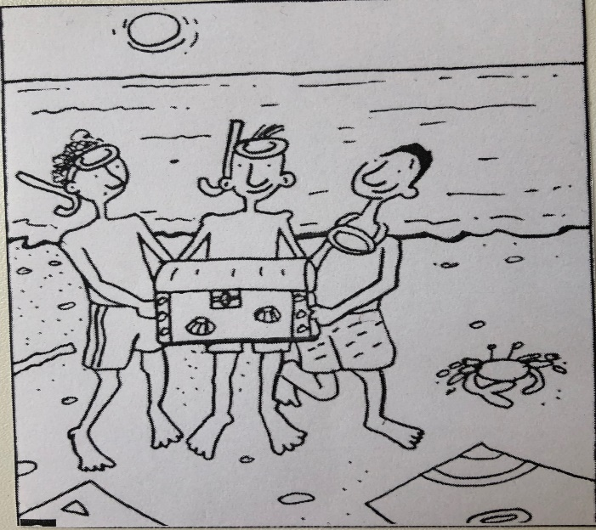
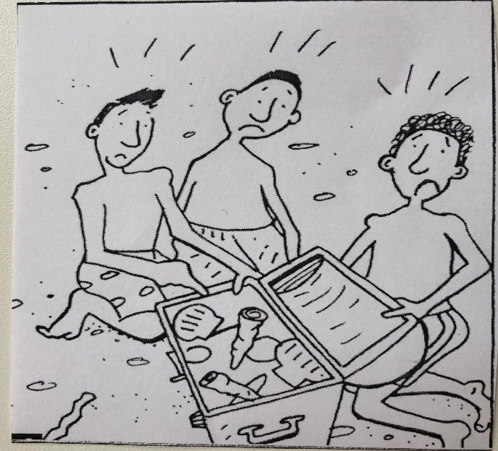
COMIC STRIPS

Slide 16
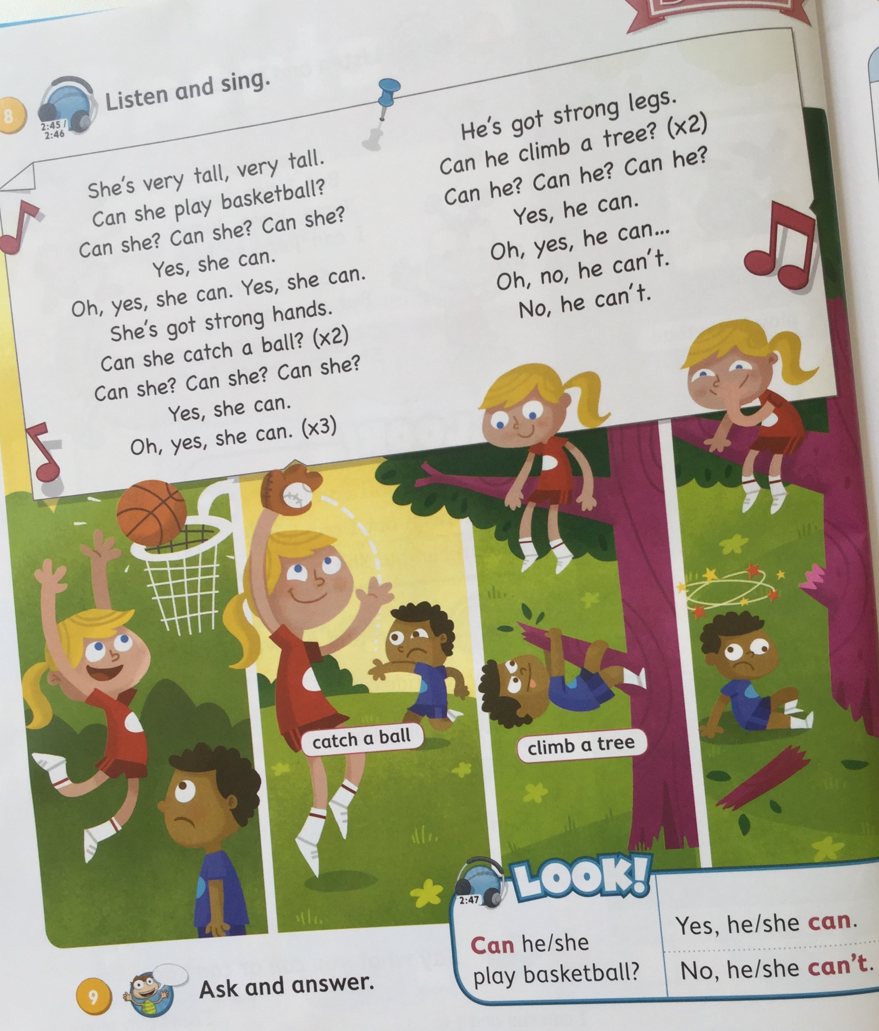
Learning Grammar through Songs
ride a bike
play baseball
play handball
kick a ball
throw a ball
Notes:
Ts: try to come up with ideas how to change the text
Show my suggestions

Slide 17
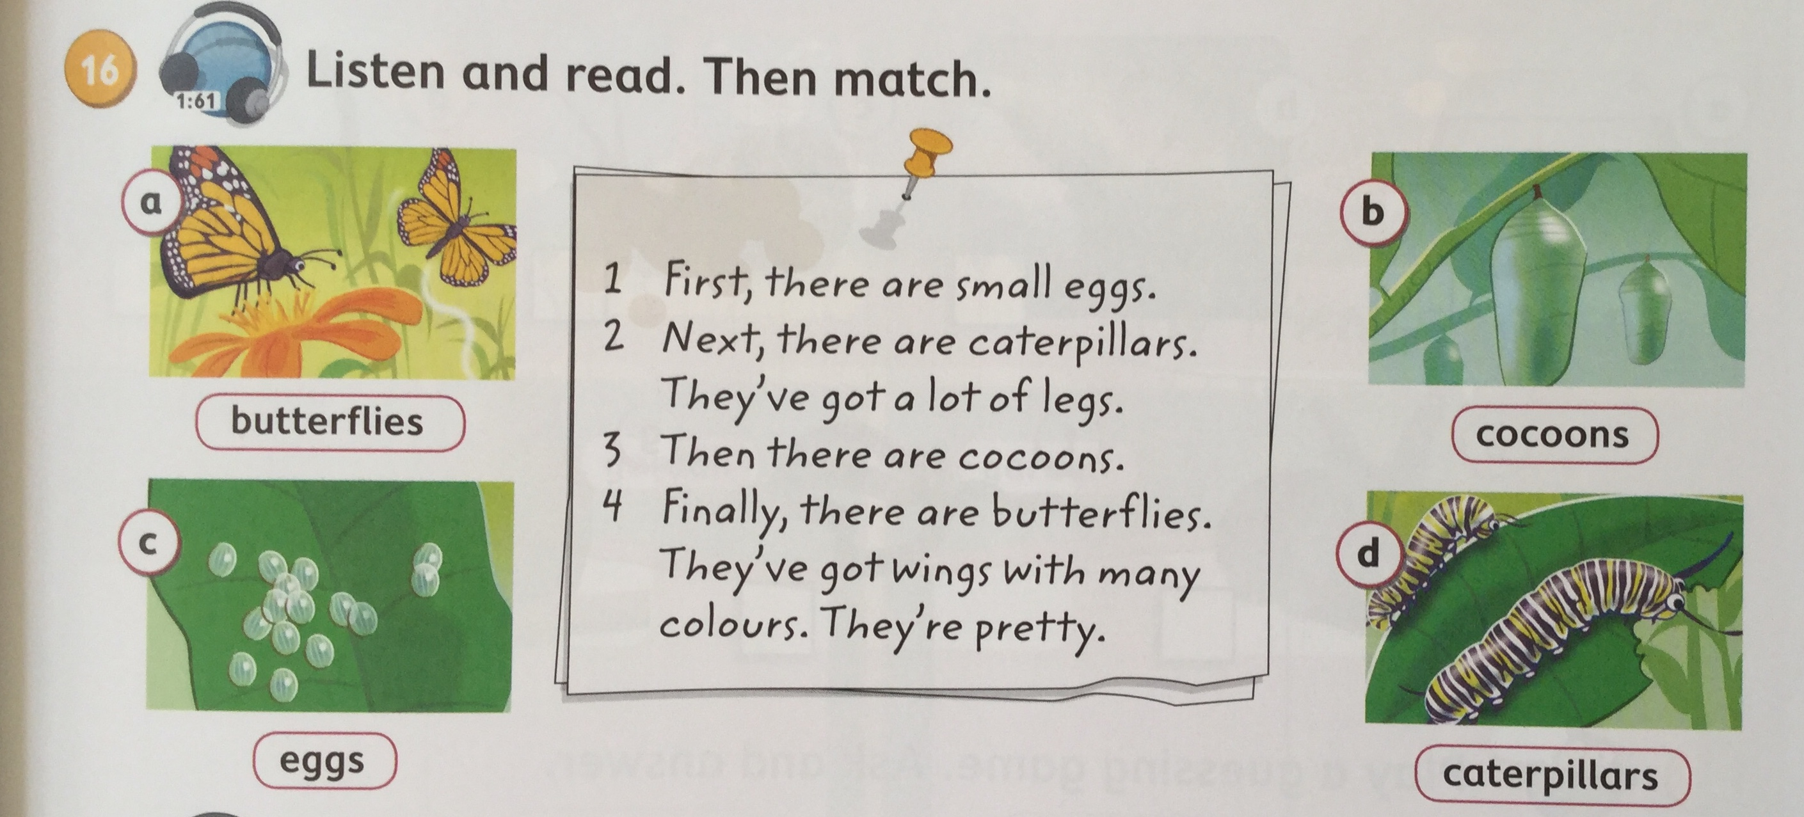
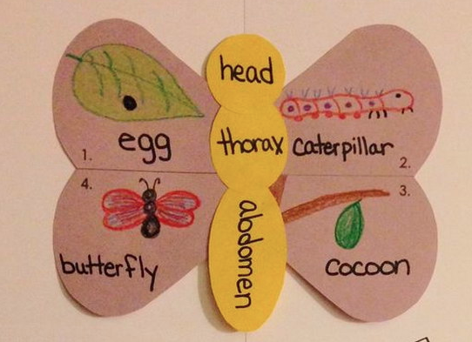

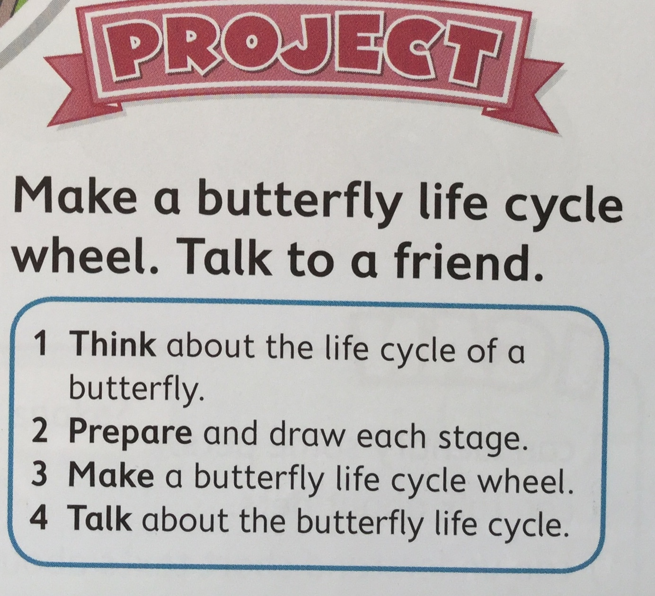
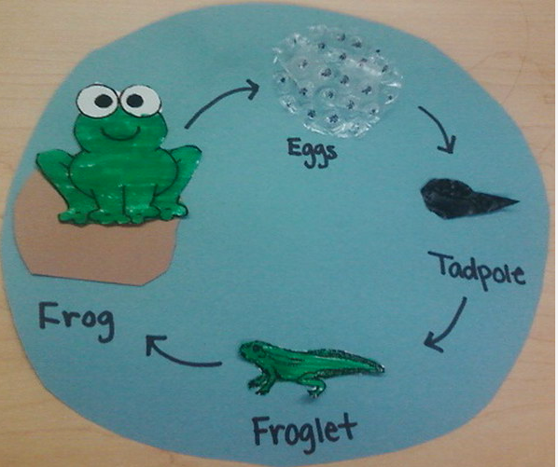
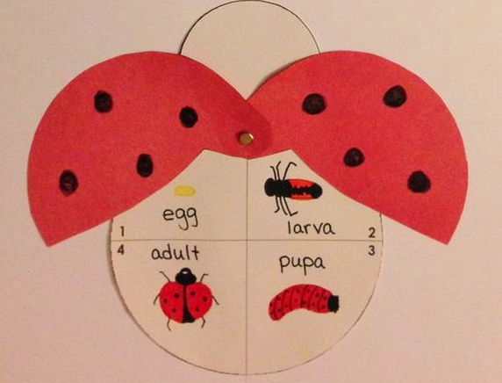

Slide 18

LISTENING
LISTEN AND MAKE A PICTURE ABOUT THE HOLIDAY DESCRIBED

Slide 19
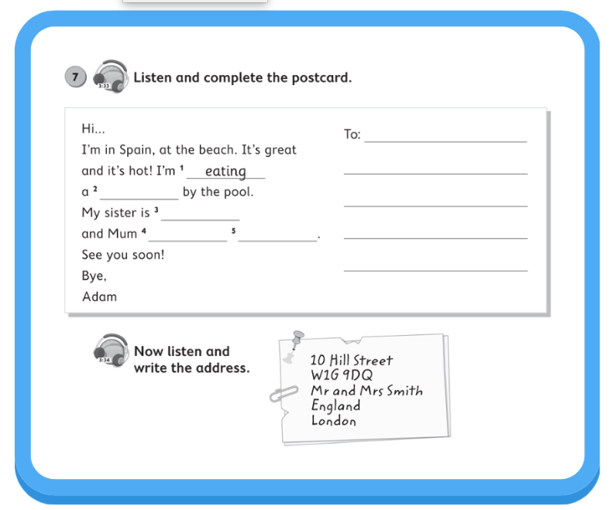
Notes:
Other possibilities –1. let your pupils read the postcard and try to guess the missing words or sentences, then play and check
2. Do the listening first, ask pupils to make the picture and then they can have a look at the text and complete it and check

Slide 20
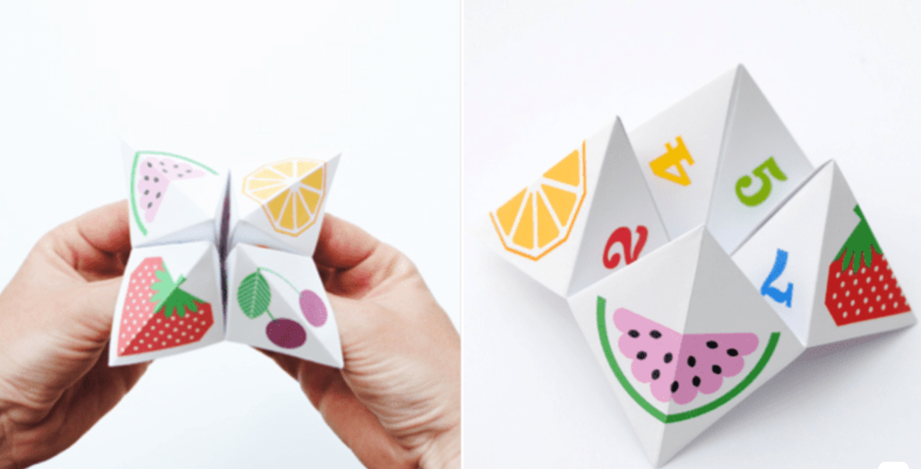
COOTIE CATCHER
Notes:
WHAT DO YOU THINK IT IS? You make it from paper, you decorate it with pictures and numbers, you prepare tasks for other people, you move your fingers, the others choose a picture, number and a task… what is it? DO YOU KNOW COOTIE CATCHER?

Slide 21
ISTRUCTIONS
Clap your hands
Look at the teacher
Go to Helen and say hello
Sing a song
YES or NO QUESTIONS
Have you got a sister?
Are there two bedrooms in your house/flat?
Can you play the piano?
Is our teacher reading?
Do you eat fruit?
OPEN QUESTIONS
What do you do in your free time?
How old are your parents?
What do you eat for lunch?
SHORT TOPICS
Speak about you and your family
Describe your room
Where you go on holiday

Slide 22
FIND SOMEONE WHO…
… CAN SKI _________? …….. CAN SKI. | … IS TERRIFIED OF SPIDERS __________? ….. IS TERRIFIED OF SPIDERS. | … HAS GOT A PET _________? …….. HAS GOT A PET.
… EATS FAST FOOD _________? ……. EATS FAST FOOD. | … WATCHED TV YESTERDAY ___________? ….. WATCHED TV YESTERDAY. | … WAS IN THE CINEMA ON FRIDAY _________? ……. WAS IN THE CINEMA ON FRIDAY.
CAN YOU SKI
TOM
Notes:
When you want to do this activity for the first time, This is a more controlled practice, it is good to put pupils to groups, you can put stronger and weaker pupils together to prepare the questions and only after that they will move around the classroom and ask their schoolmates. The next time, or when your pupils get used to this type of an activity, you can give them a more simple worksheet with the list of things they are supposed to find out,

Slide 23
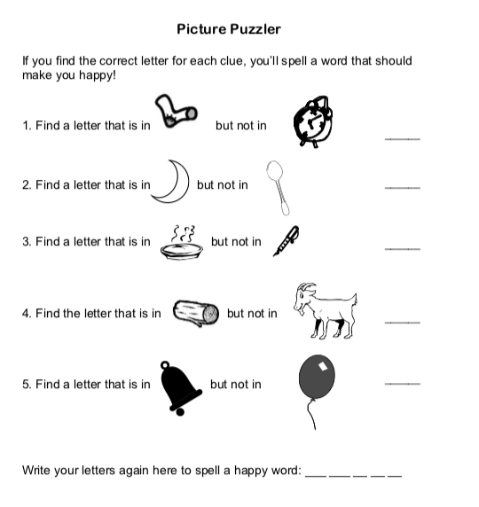
LOGIC SMART
S
SOCK
CLOCK
M
MOON
SPOON
I
PIE
PEN
L
LOG
GOAT
E
BELL
BALLOON
Try to make your own riddle like the one above for the words cat, dog, sun, fish
Notes:
Sock – clock, moon – spoon, pie – pen, log – goat, bell - baloon

Slide 24
REFERENCES
http://hative.com/life-cycle-projects-for-kids/
https://eltexperiences.com
https://www.lauracandler.com
https://www.teachingenglish.org.uk
https://www.eslkidstuff.com/flashcardgamescontent.htm
https://www.spelling-words-well.com
https://www.thesprucecrafts.com/make-these-creative-cootie-catchers-4149965

Slide 25



Tel. +420 725 578 551
zuzana.pohlova@venturesbooks.com

