Slide 1
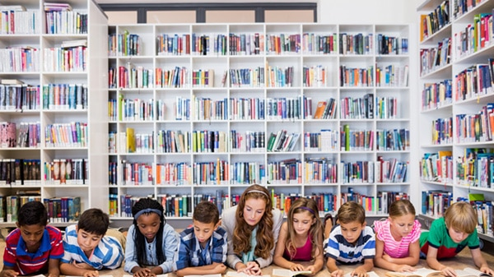

READING IS NOT A WASTE OF TIME
by Judita Tóthová

Slide 2

reading for pleasure
reading comprehension strategies
reading comprehension activities

Slide 3
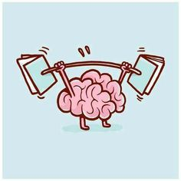
“Reading is to the mind what exercise is to the body.“
(Joseph Addison)

Slide 4

1/“There is no ? as loyal as a book.” (Ernest Hemingway)
2/“Books are a uniquely portable ?. ” (Stephen King)
3/“Reading should not be presented to children as a duty.
It should be offered as a ?. (Kate DiCamillo)
friend
magic
gift

Slide 5

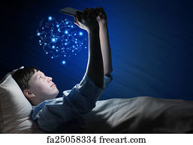

Reading is my superpower.
My workout is reading in bed until my arms hurt.
I love reading because I don´t have to wait
for the commercials to be over to find out
what happens.

Slide 6

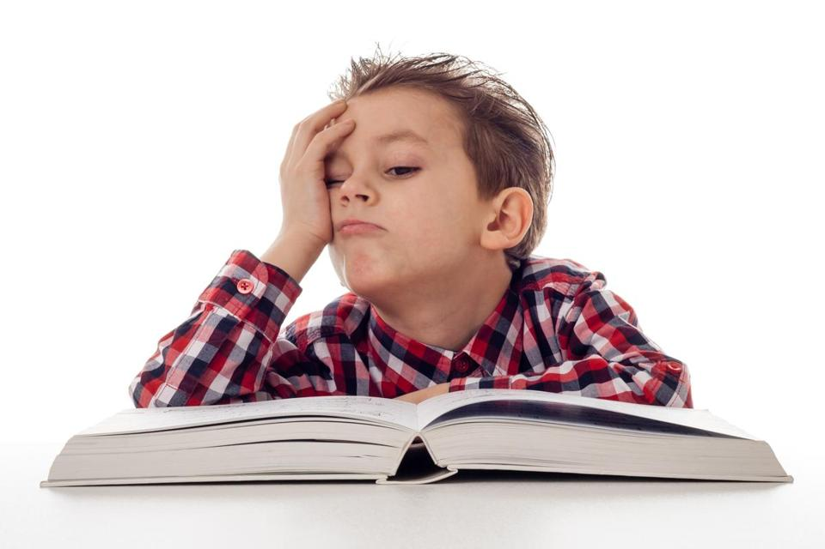
Reading is boring!
Reading is wonderful!

Slide 7

Be a reading model for students

Slide 8
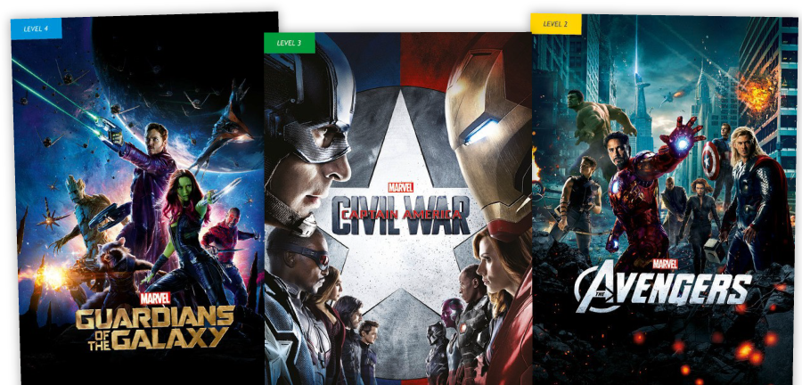
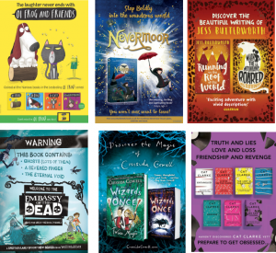
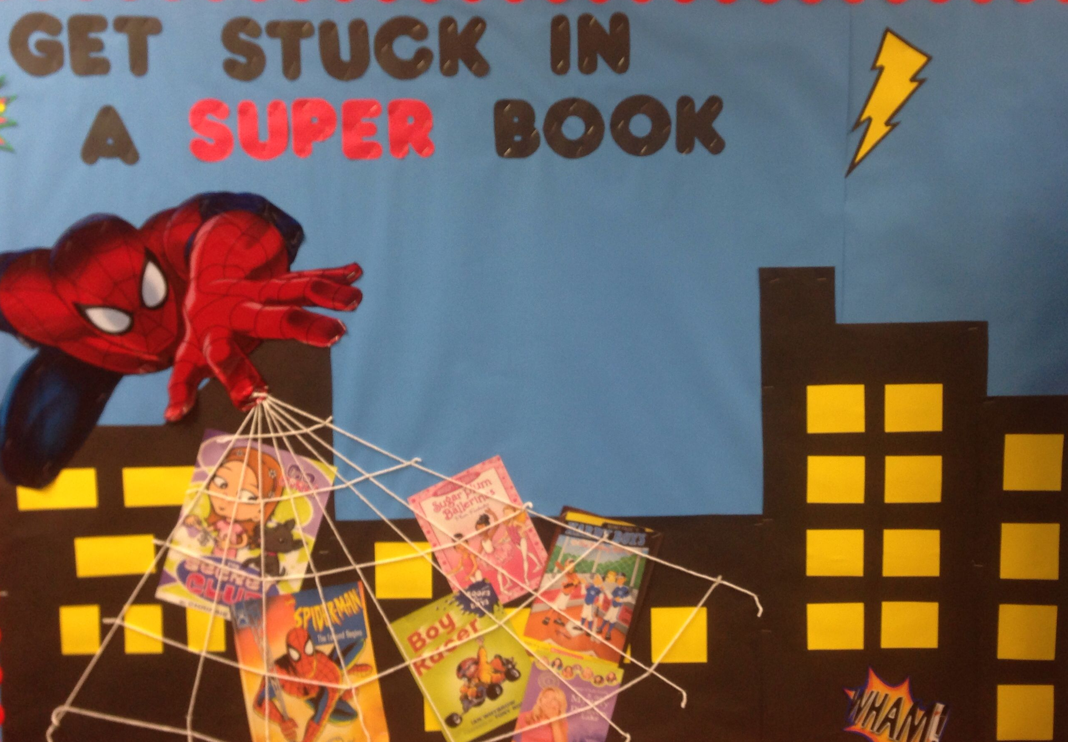
Reading wall

Slide 9
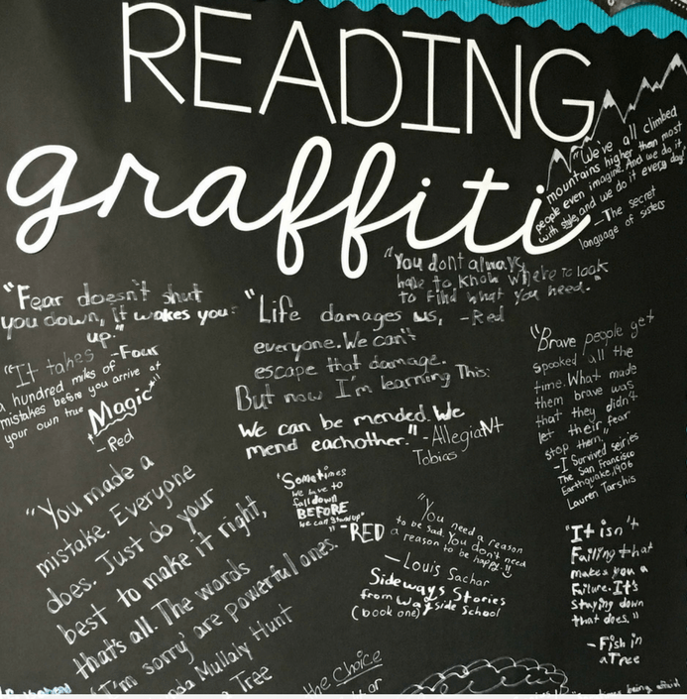
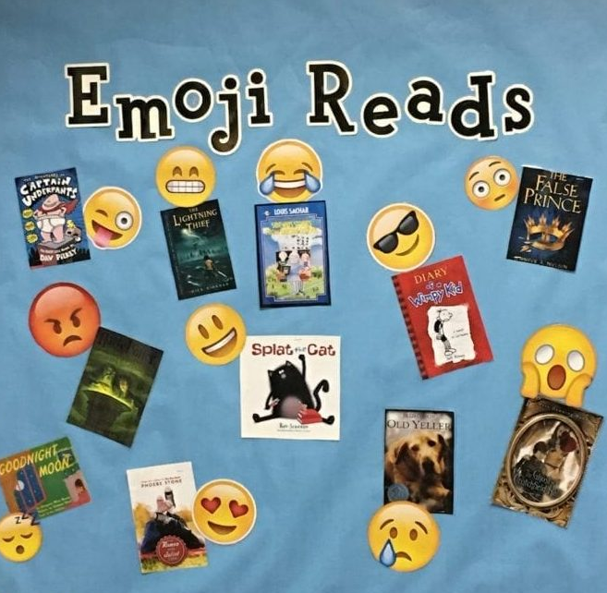
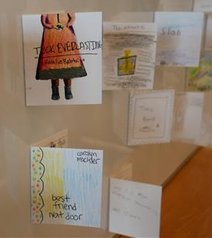
Reading wall

Slide 10

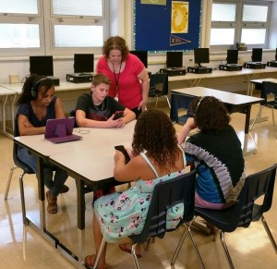
bring stories to life
model correct pronunciation and intonation
provide additional listening practice
highlight characters´ feeling, humour
help struggling readers
are useful for students with learning disabilities
Audio CD
Audiobooks

Slide 11
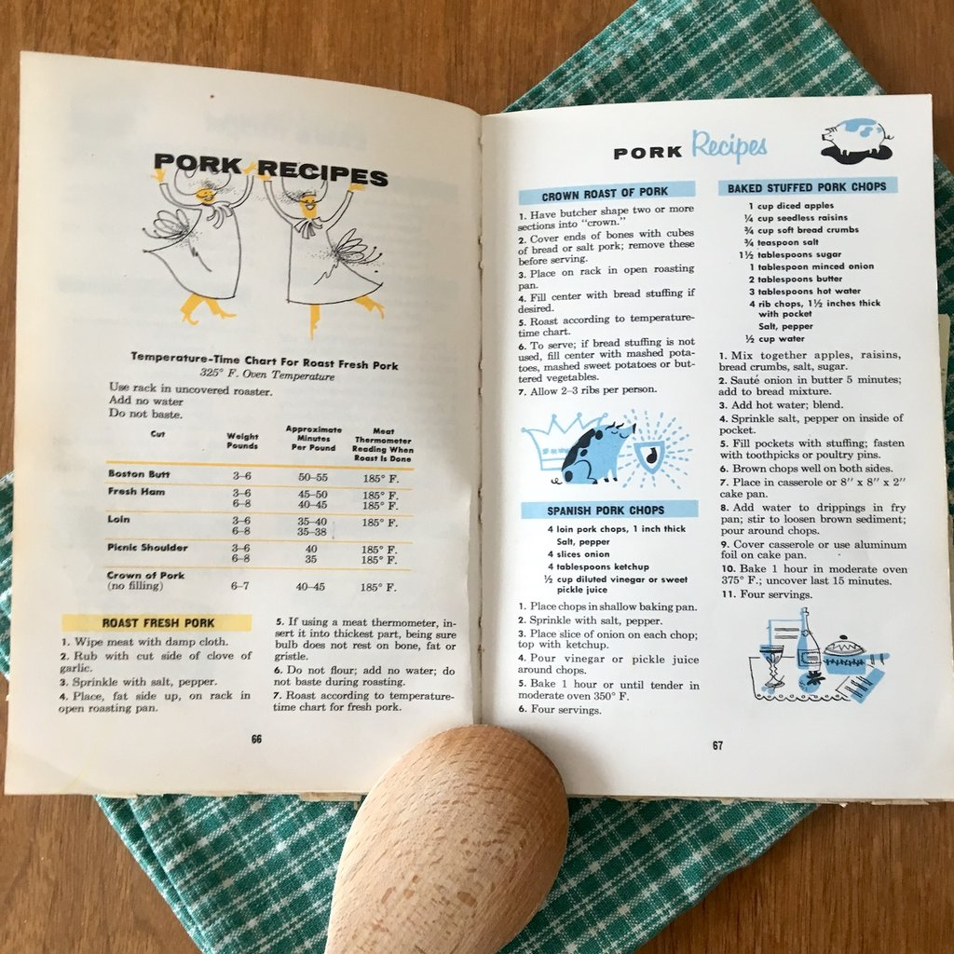

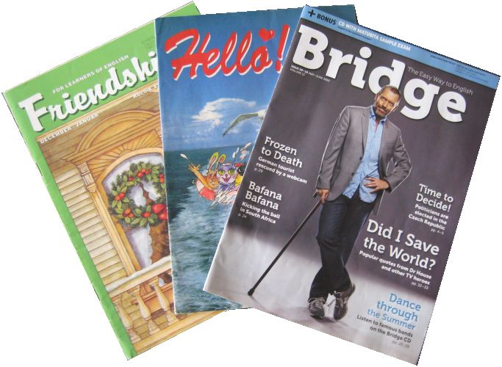
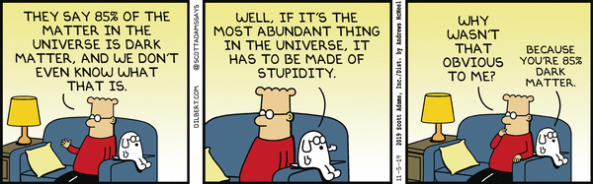
Think outside the box

Slide 12

comprehension
decoding the content
connection between the text and knowledge
interpretation
questioning
expressing feelings, opinions

Slide 13
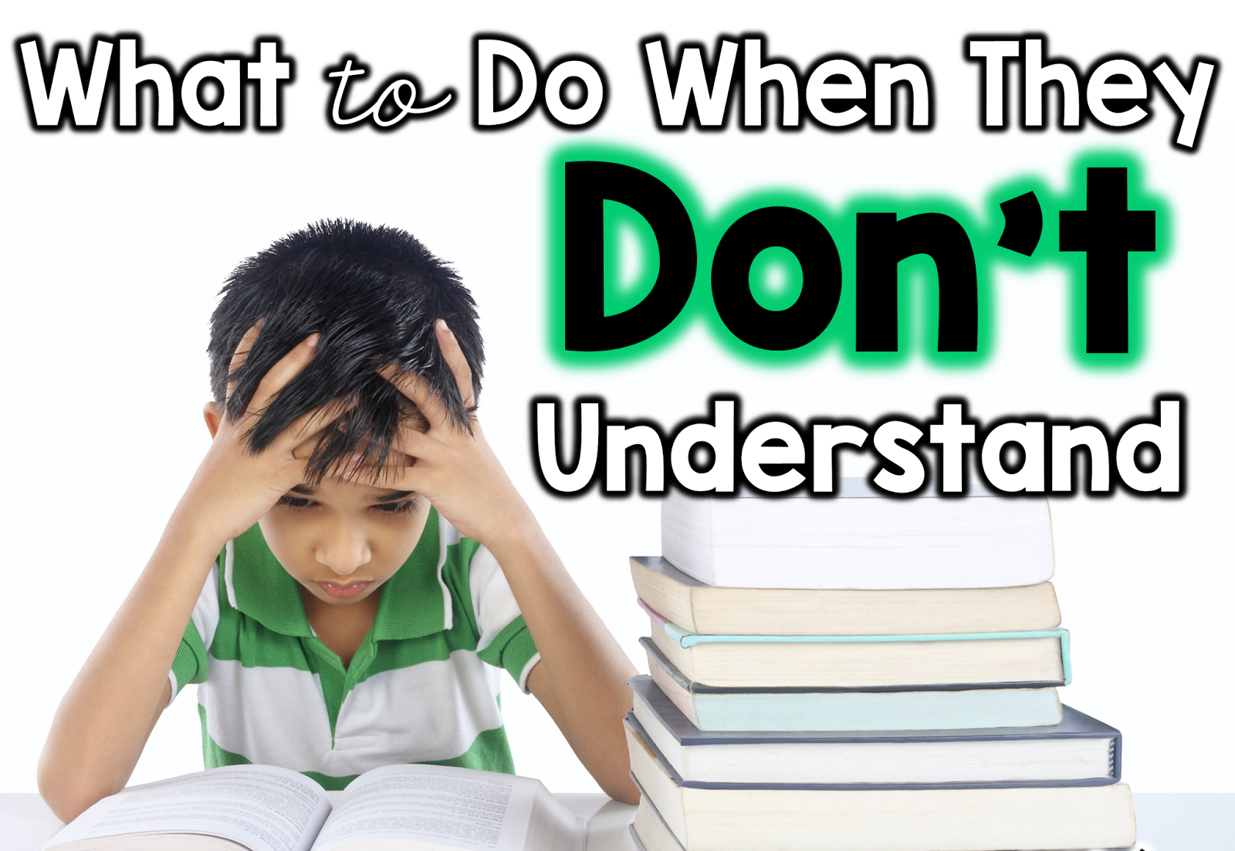
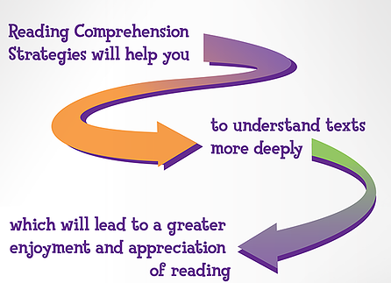

Slide 14
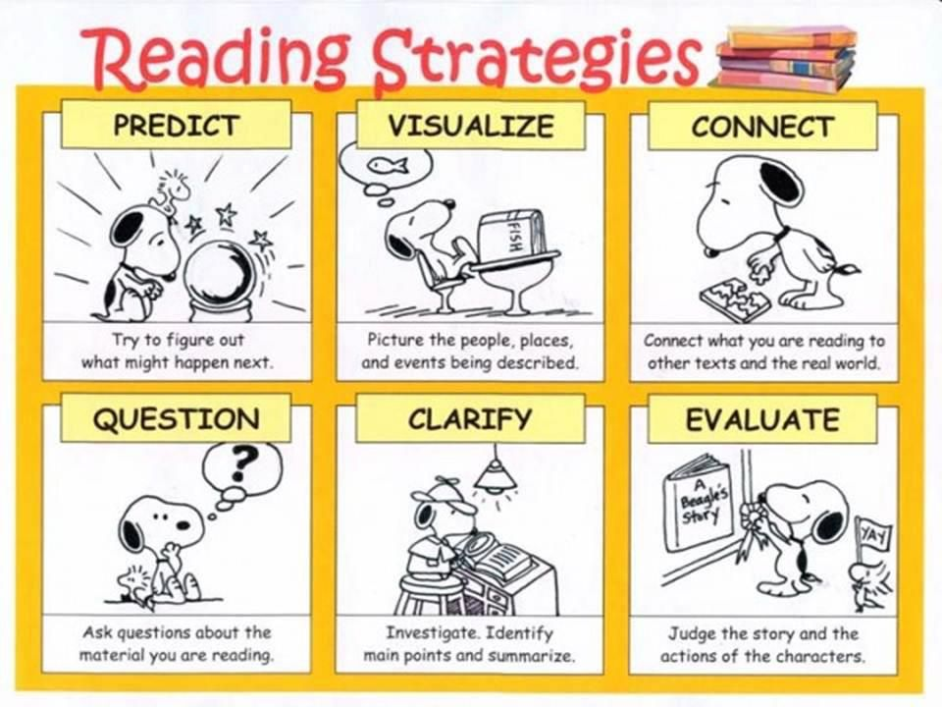
Reading comprehension strategies
predicting
questioning
clarifying
visualising
connecting
evaluating

Slide 15
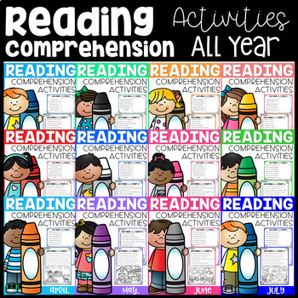

Slide 16
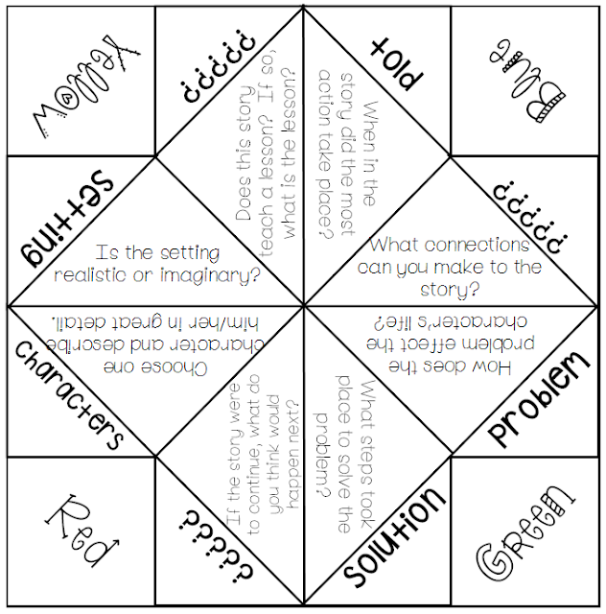
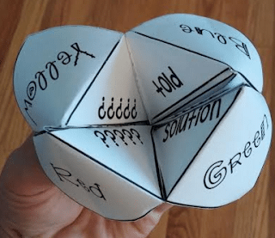
FORTUNE TELLER
(COOTIE CATCHER)
https://www.youtube.com/watch?v=nreDjXoCCpI how to use fortune teller
https://www.youtube.com/watch?v=PAZKv_PVcn0 how to make fortune teller

Slide 17
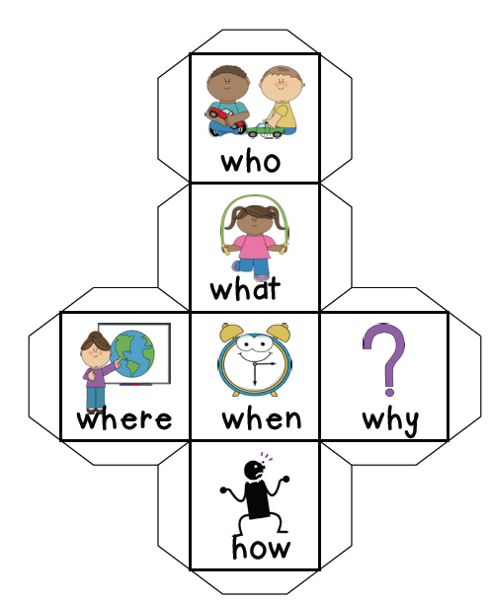
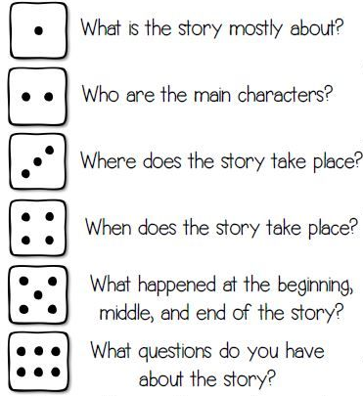
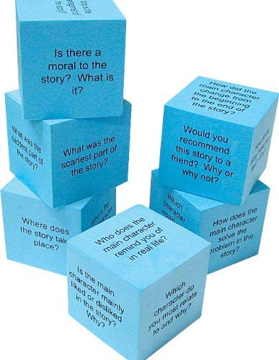
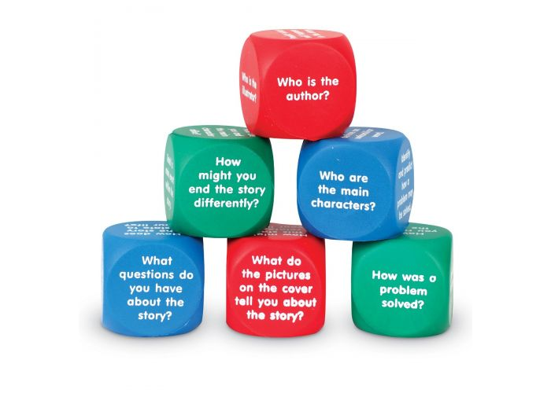
READING COMPREHENSION CUBES

Slide 18
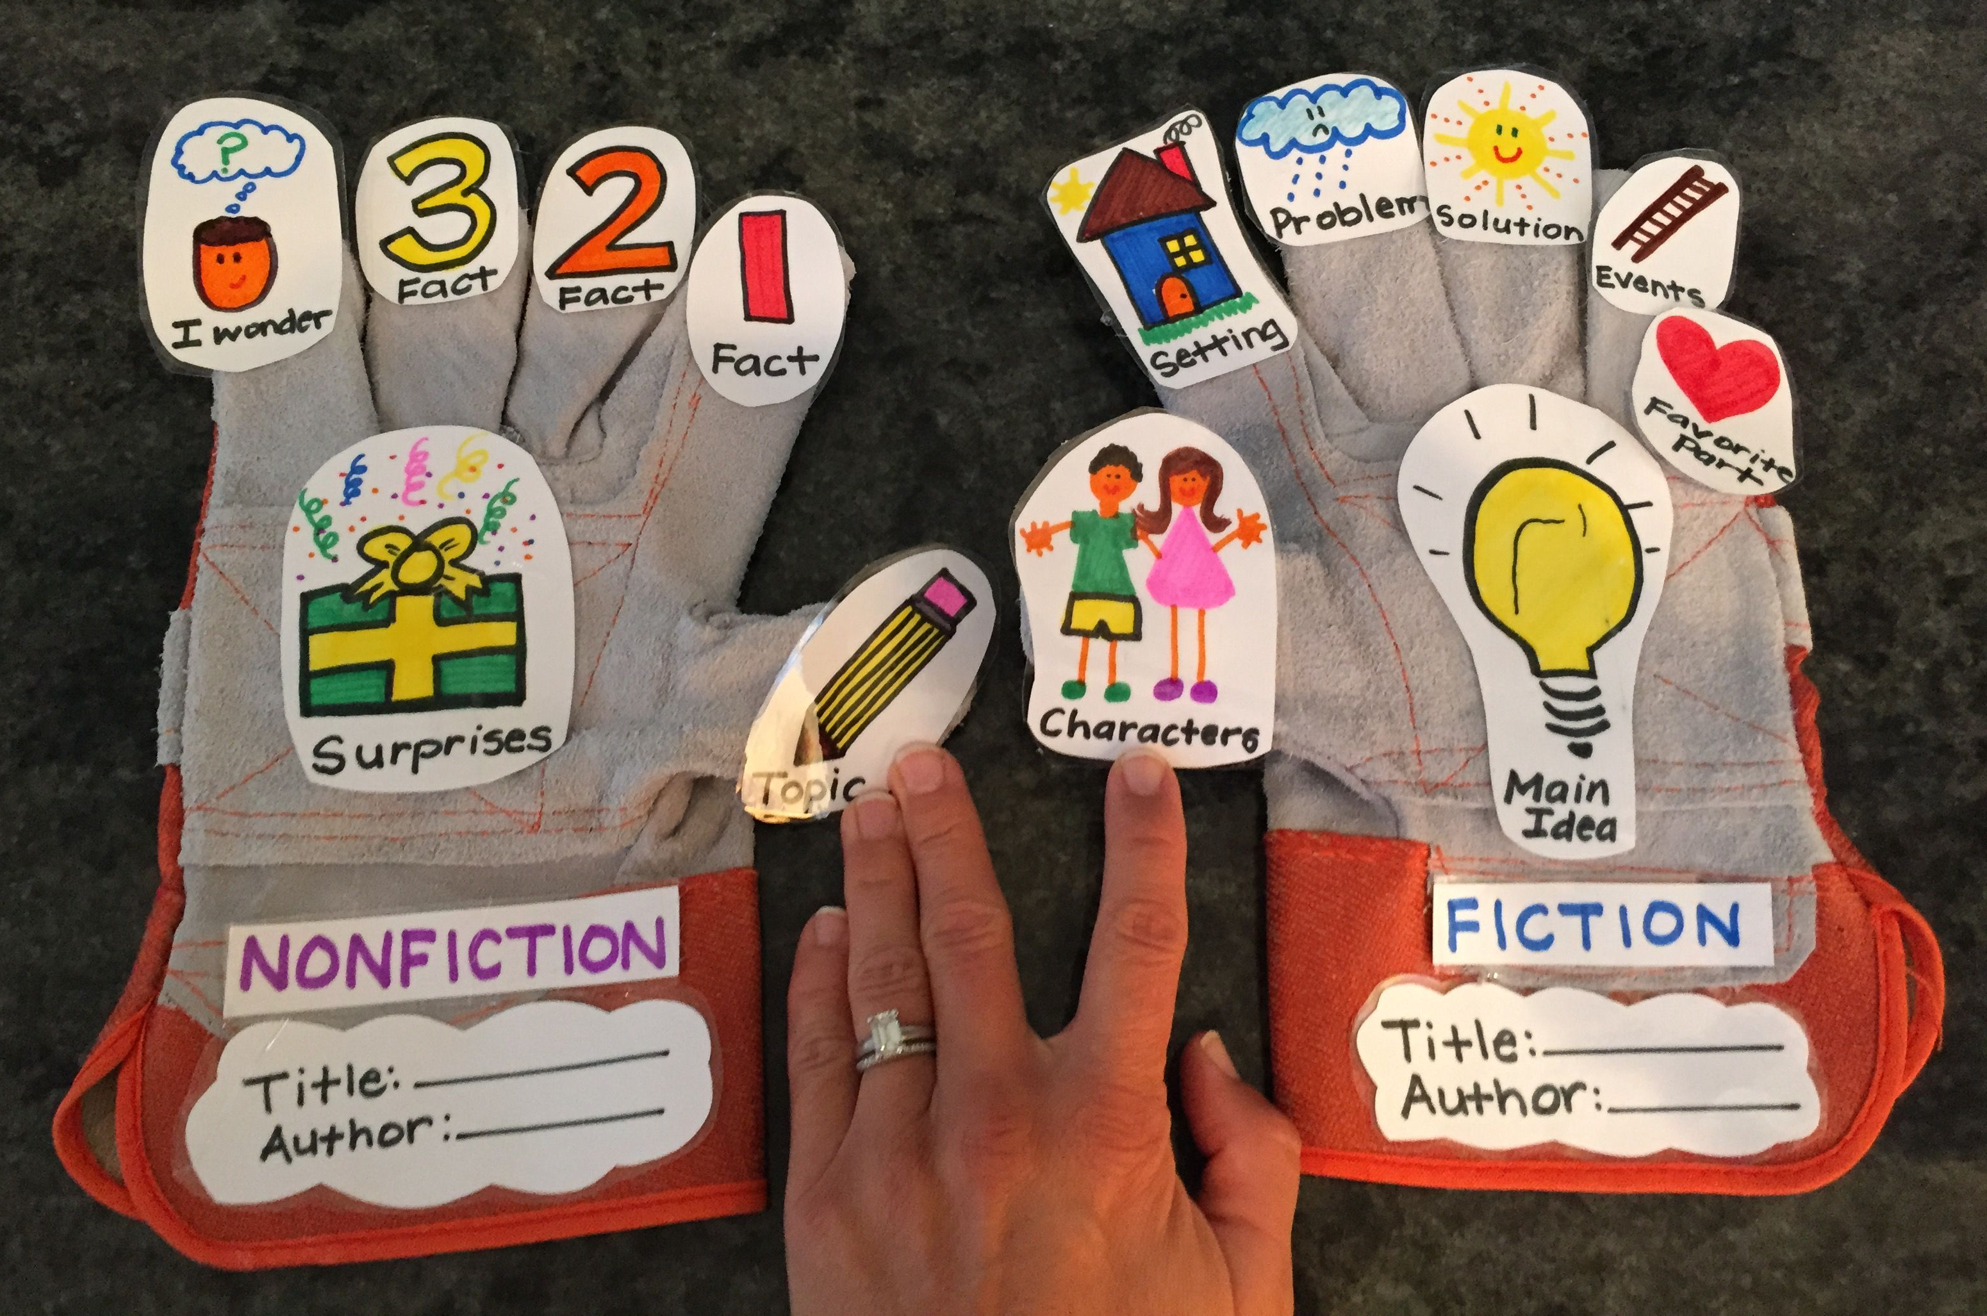
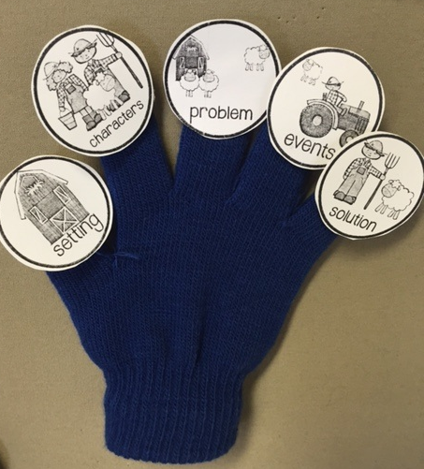
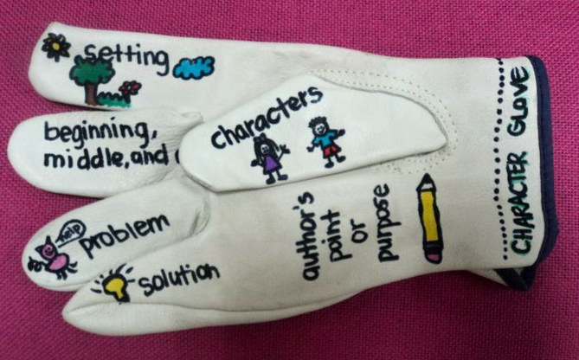
RETELLING GLOVES

Slide 19
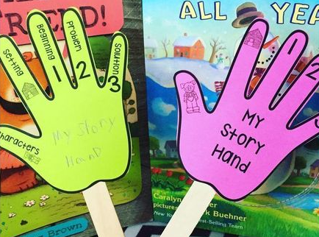
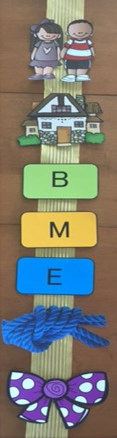
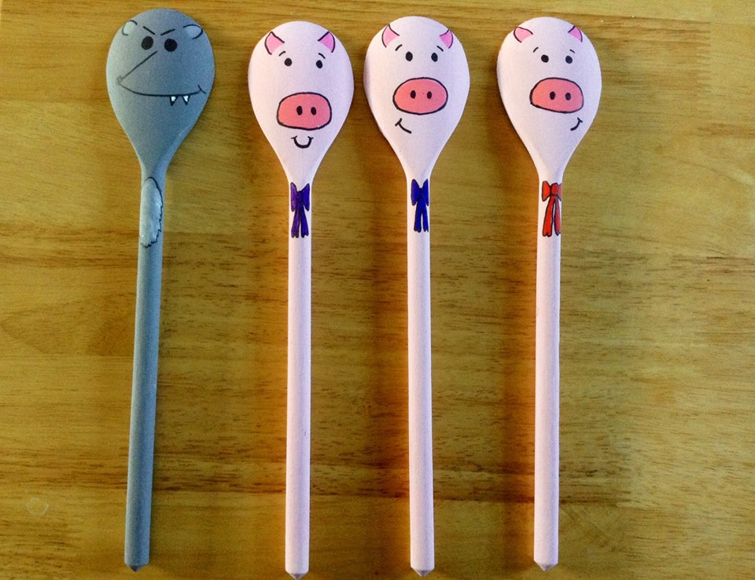
RETELLING STICKS/ROPE

Slide 20
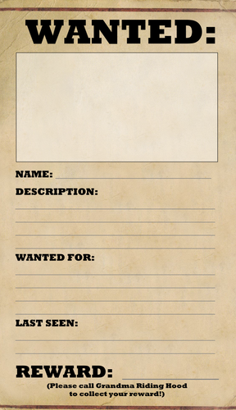
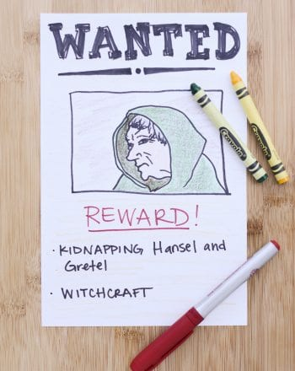

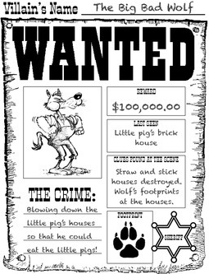
WANTED POSTER

Slide 21
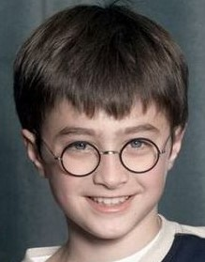

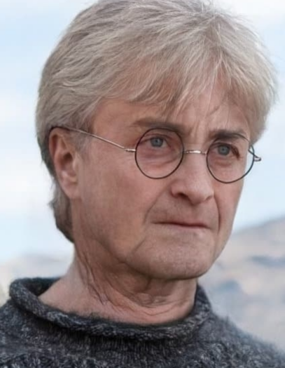
Lifetime Tale in Pictures
child
adult
old person

Slide 22
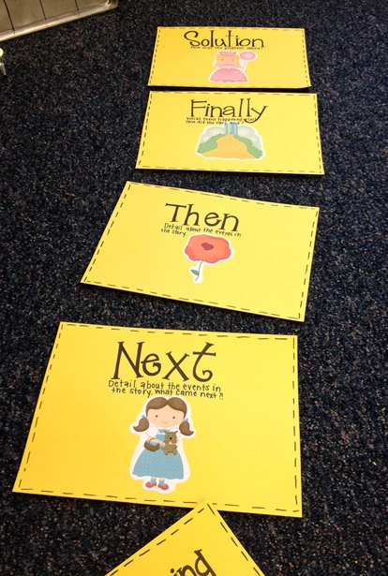
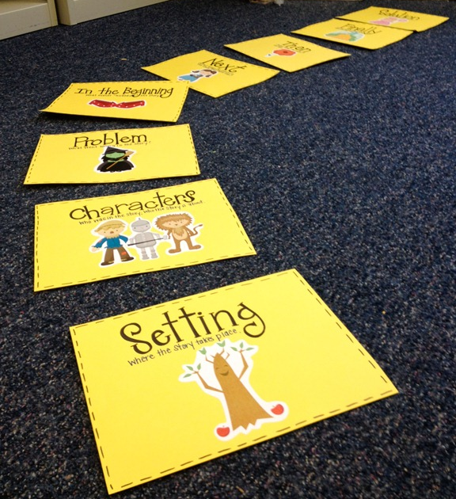
YELLOW BRICK ROAD

Slide 23
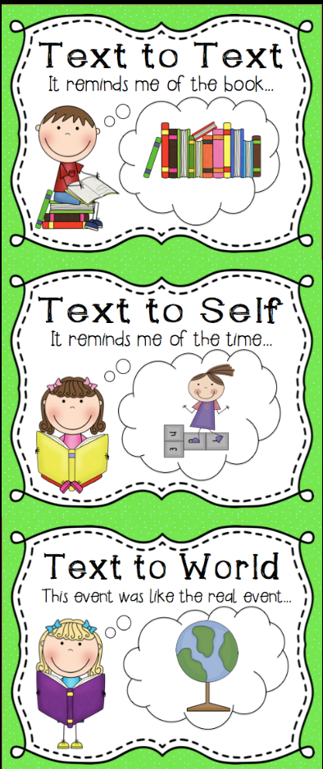
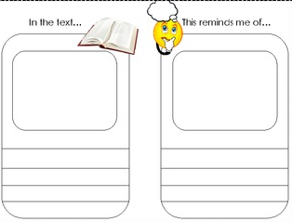
What does this remind you of in another book you have read?
How is this text similar to other things you have read?
Does anything in this story remind you of anything in your own life?
Can you relate to the characters in the story?
TEXT TO...
What does this remind you of in the real world?
How are events in this story similar to things that happen in the real world?

Slide 24
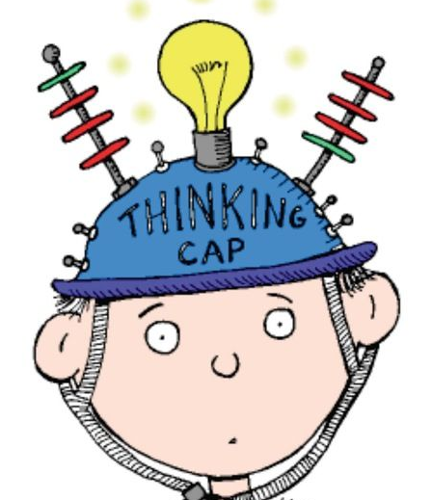
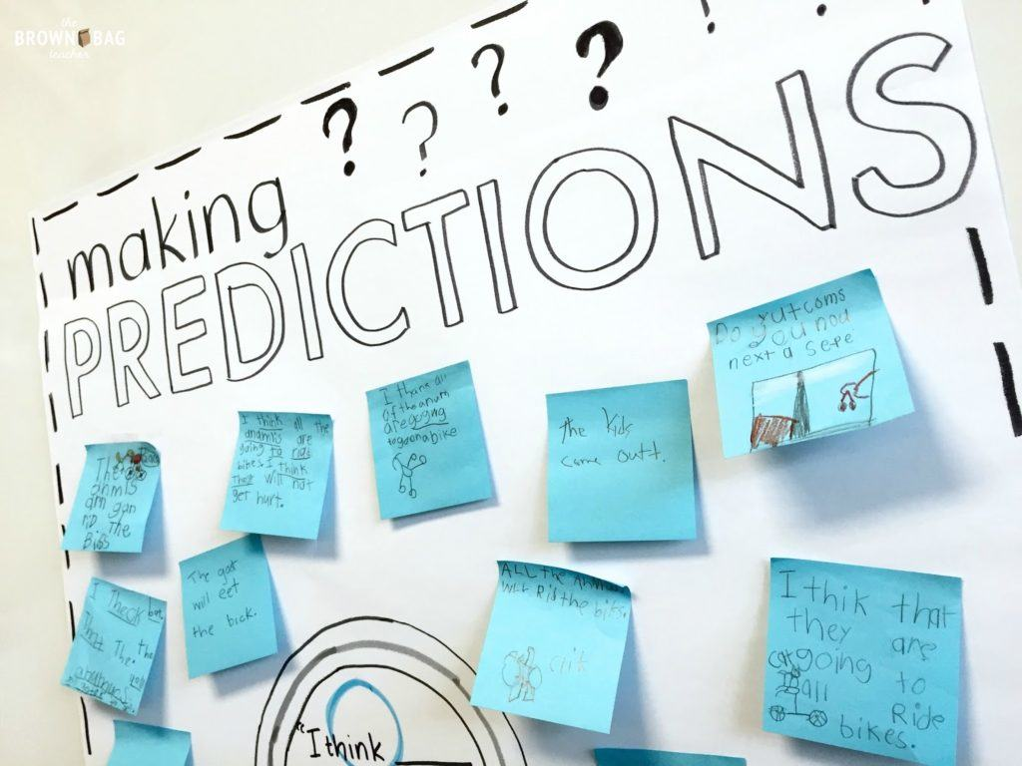

Slide 25

I think the book is about 2 boys. One of the boys looks like he is in prison and he has made friends with the boy who isn´t. I think the boy in the pyjamas is the main character.
First I looked at the title and predicted the book will be about a boy. Then I looked at the picture and noticed the fence. That´s why I predicted that one of the boys is in prison.
I guessed that the main character of the book is the boy in the pyjamas because it relates to the heading.
I predicted he is the prisoner, because I know that people in prison wear clothes similar to his clothes.
John Boyne

Slide 26

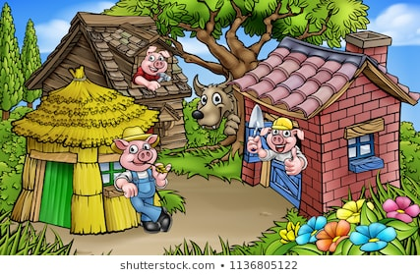
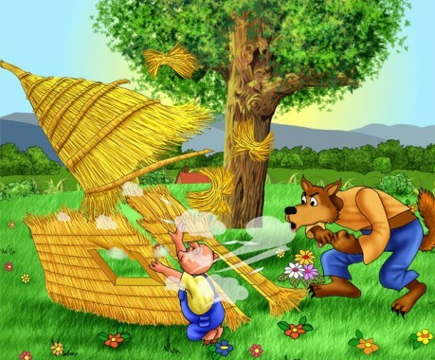
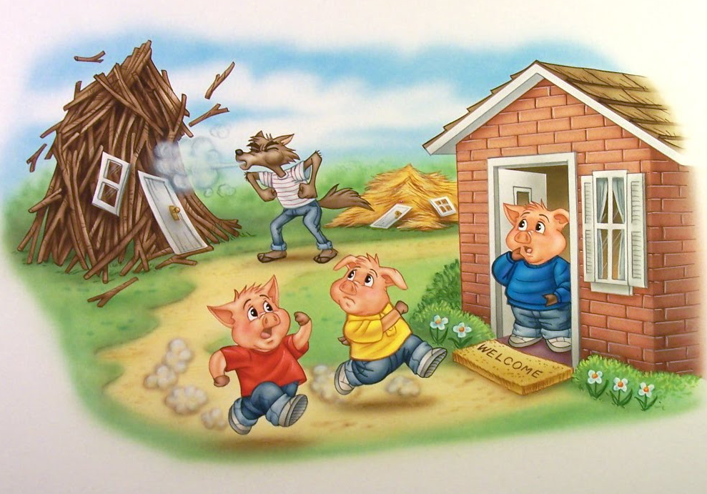

Slide 27



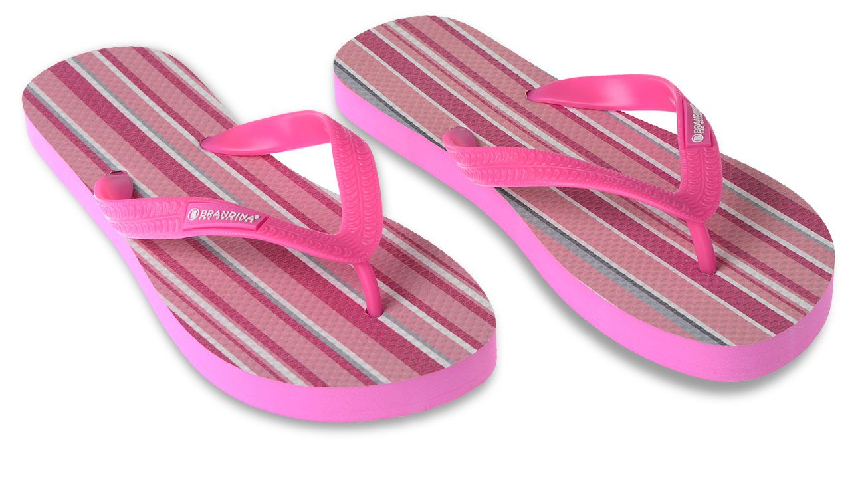
“Molly, come get in the
car,“ said Mum. “It´s time to
go. Dad and Bud are waiting.“
“But I can´t find my towel,“
Molly screamed back.
“I have your towel in the
bag. Just get your flip flops on
and let´s go. It´s a beautiful,
sunny day and we don´t want
to miss any of the fun.“
Molly slipped her flip flop on
as fast as she could and climbed
into the back seat.
It was going to be a long ride.

Slide 28

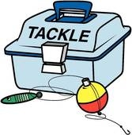

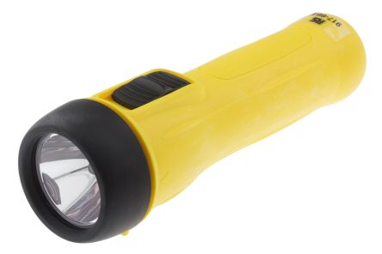
Molly knew it is going to be
a long ride so she grabbed her
sleeping bag and rested her head
on it.
The boot of the car was
filled with everything they needed
for the trip. Dad´s fishing rod and tackle box were rattling in the
back. Bud was playing with a torch
in his hands.

Slide 29
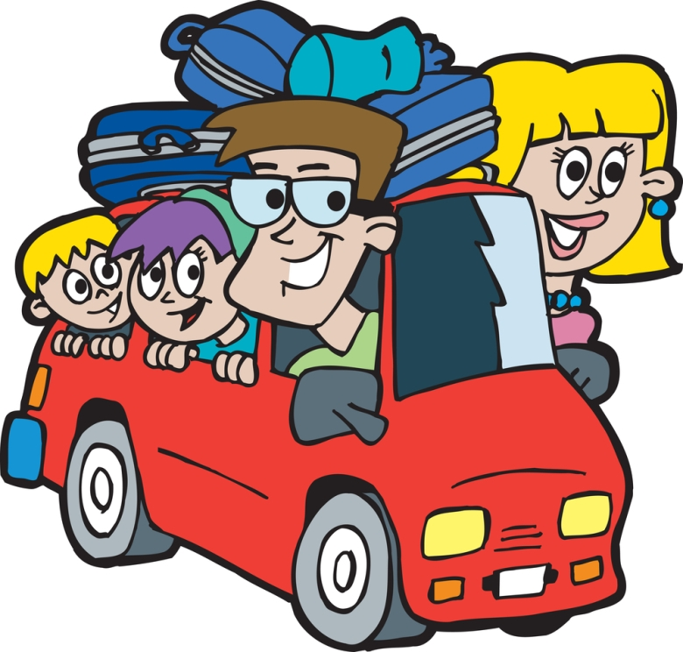

The family was off on
their holiday. The two-hour
drive would bring them to
Camp Rest and Relax, their
favourite place to go to
every summer.

Slide 30
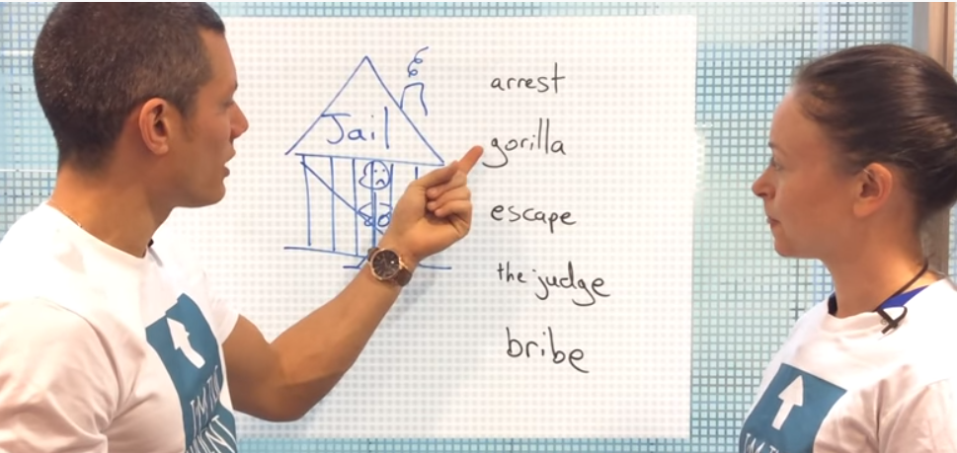

Slide 31
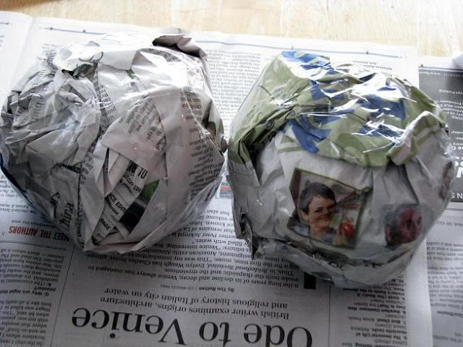
“SCREW UP“
skimming - reading for gist
gist is the general meaning of the text

Slide 32


“GRASS SKIRT“
scanning - reading for specific information

Slide 33
READING COMPREHENSION ACTIVITY QUIZ
activities | before | during | after
1/ fortune teller
2/ reading cubes
3/ retelling gloves, sticks, rope
4/ wanted poster
5/ lifetime tale
6/ yellow brick road
7/ text to...
8/ prediction
9/ screw up
10/grass skirt

Slide 34
READING COMPREHENSION ACTIVITY QUIZ
activities | before | during | after
1/ fortune teller | X
2/ reading cubes
3/ retelling gloves, sticks, rope
4/ wanted poster
5/ lifetime tale
6/ yellow brick road
7/ text to...
8/ prediction | X
9/ screw up | X
10/grass skirt | X

Slide 35
READING ACTIVITY COMPREHENSION QUIZ
activities | before | during | after
1/ fortune teller |  | X
2/ reading cubes |  | X
3/ retelling gloves, sticks, rope |  | X
4/ wanted poster |  | X
5/ lifetime tale
6/ yellow brick road
7/ text to...
8/ prediction |  | X
9/ screw up
10/grass skirt

Slide 36
READING ACTIVITY COMPREHENSION QUIZ
activities | before | during | after
1/ fortune teller |  |  | X
2/ reading cubes |  |  | X
3/ retelling gloves, sticks, rope |  |  | X
4/ wanted poster |  |  | X
5/ lifetime tale |  |  | X
6/ yellow brick road |  |  | X
7/ text to... |  |  | X
8/ prediction
9/ screw up
10/grass skirt

Slide 37


“You cannot open a book without learning something.”
(Confucius)
“All I have learned, I have learned from books.”
(Abraham Lincoln)
Notes:
,

Slide 38

https://readers.english.com/
https://www.venturesbooks.sk/produkty/zjednodusene-citanie-v-anglictine
https://www.venturesbooks.cz/produkty/zjednodusena-cetba

Slide 39



judita.tothova@venturesbooks.com
www.venturesbooks.sk
www.venturesbooks.cz

Slide 40


Slide 41



Slide 42

Reading comprehension strategies

Slide 43



TEXT TO SELF
TEXT TO TEXT
TEXT TO WORLD

Slide 44




Foldable brochure

