Slide 1

How to Succeed
in English

Slide 2
What do we offer?
  Complete offer of English language teaching materials
  Distribution of other major world ELT publishing houses
  Simplified Pearson Readers
  Textbooks for all other school subjects from elementary schools to high schools, office, school, and art supplies
  Distribution of educational games Regipio
  www.venturesbooks.cz www.venturesbooks.sk

Slide 3
Methodological support
  Seminars, webinars and conferences
  Teaching tips for teachers/students
  Sample lessons at schools
  ELT consulting
  Teacher’s set for free
  Free samples www.venturesbooks.cz www.venturesbooks.sk

Slide 4
Distribution
Loyalty programme for schools
Textbooks reservations
Individual price offer
For more information and complete offer: shop.venturesbooks.cz shop.venturesbooks.sk

Slide 5

About iSucceed in English
Level differentiation
Components
What’s great about it?
Unit walkthrough
Key features of iSucceed in English

Slide 6


About iSucceed in English

Slide 7

1
What is it?
Who is it for?
Course: global semi-intensive
Language: British English
Learner age: 10 - 15
Hours per week: 3 - 5
Levels: 5
GSE Range: 16 - 54
CEFR Level: A1 - B1+
Institutions: state/private/language schools
Teachers: non-native in mixed-ability classes

Slide 8
Level differentiation

Slide 9






1
CEFR: A1
GSE: 16-23
CEFR: A1+
GSE: 20-30
CEFR: A2
GSE: 28-38
CEFR: A2+
GSE: 36-46
CEFR: B1/B1+
GSE: 44-54

Slide 10
Level 1
Levels 2-3
Levels 4-5
10-page long units
one page for Vocabulary lessons
one page for Skills Trainer sections
no Citizenship video
12-page long units
double-page spreads for Vocabulary lessons
Citizenship videos from Level 2
14-page long units
double-page spreads for Skills Trainer sections
separate one-page long Writing lessons

Slide 11
1
CEFR: A1
GSE: 16-23
CEFR: A1+
GSE: 20-30
CEFR: A2
GSE: 28-38
CEFR: A2+
GSE: 36-46
CEFR: B1/B1+
GSE: 44-54

Slide 12
Components

Slide 13

Components
Student
Teacher
Print
Student’s Book & eBook
SB & eBook with Online Practice + Extra Practice Activities
Workbook (with Ss resources)
WB with Online Practice Access Code + Extra Practice Activities
Digital
Student’s eBook
Access Code
Online Practice Access Code + Extra Practice Activities
Student’s eBook with Online Practice Access Code + Extra Practice Activities
Print
Teacher's Book & Teacher's Portal Access Code​
Digital
Teacher’s Portal Access Code​
Teacher's Portal All Levels Access Code​
Validity of access codes: 36 months
Validity
of access codes:
24 months

Slide 14


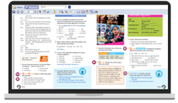
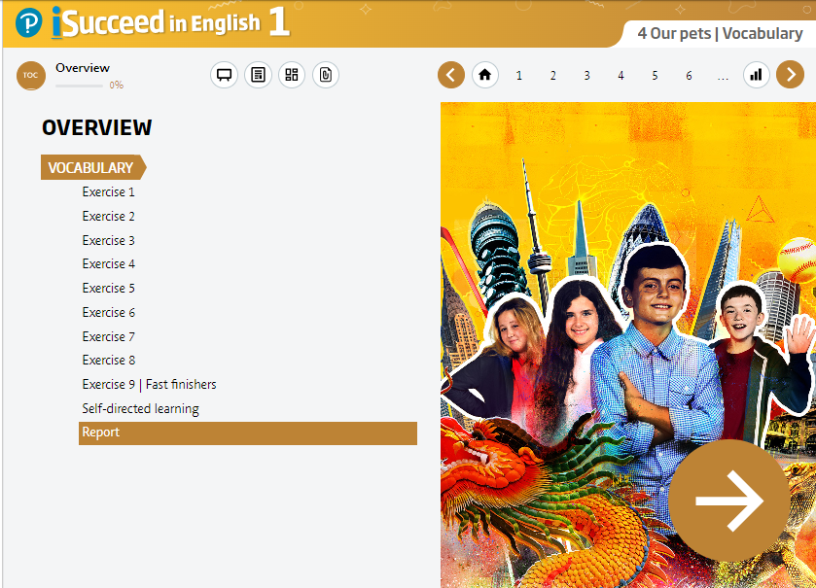


Student Components
Student’s Book & eBook
Student’s Book& eBook with Online Practice
Workbook with access code
to Ss’ resources
Workbook with access code to Online Practice
Online Practice: Workbook + Extra Practice Activities
Students’ resources: all course audio and video

Slide 15
What is great about
iSucceed in English?

Slide 16



The first Pearson teenage course
with the UN Sustainable Development Goals

Slide 17
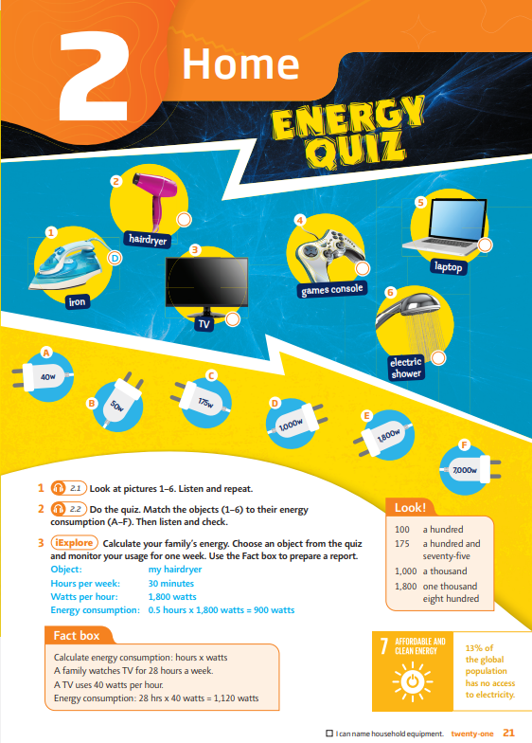
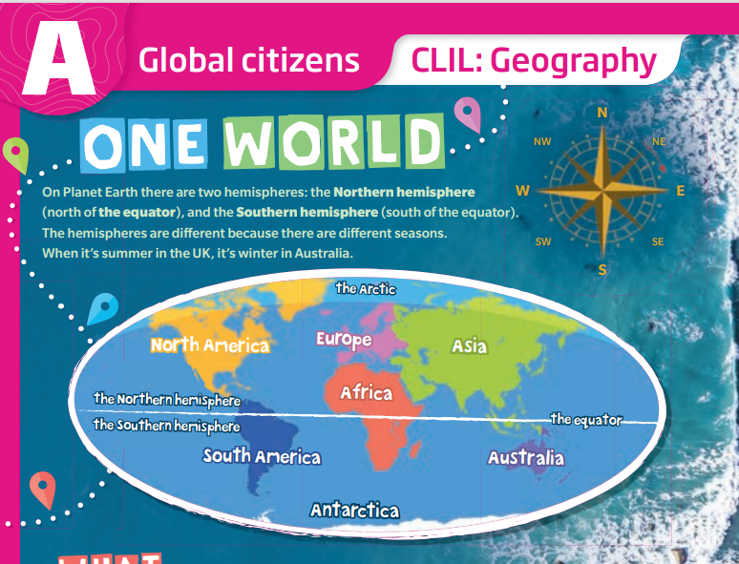



Sustainable Development Goals
Global citizens sections

Slide 18
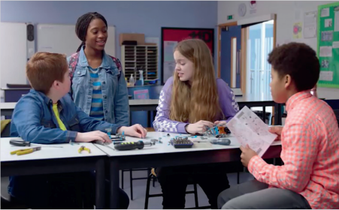
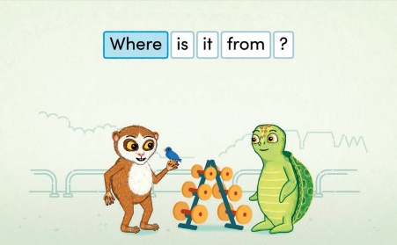
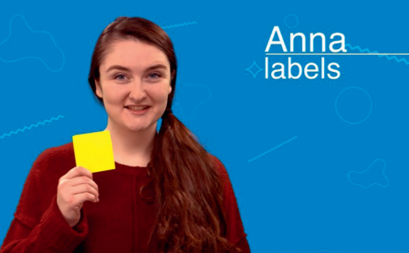
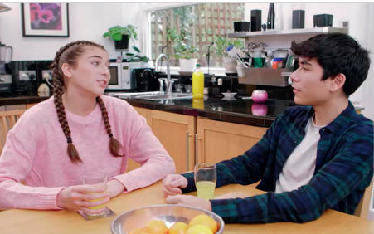


Multimedia content with high educational value
Grammar video presentation
iExplore Grammar animations
Learn to learn
Function videos
Culture videos
Citizenship videos

Slide 19
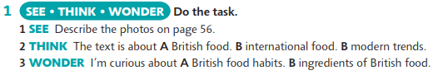

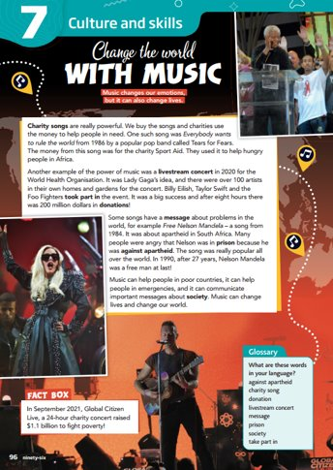
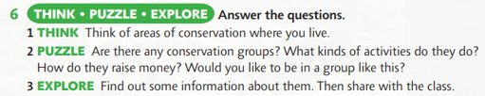

Visible thinking routines to think critically and creatively
https://pz.harvard.edu/projects/visible-thinking
https://pz.harvard.edu/thinking-routines

Slide 20
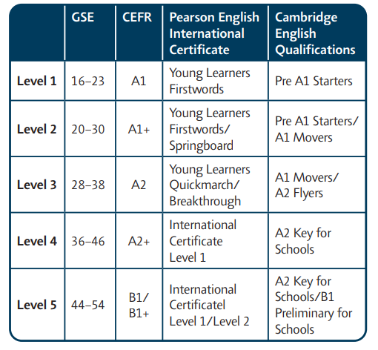
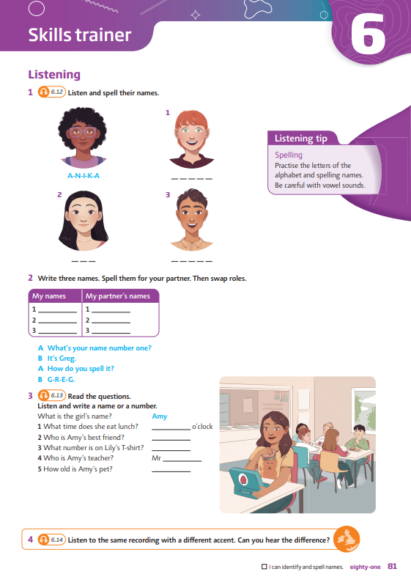
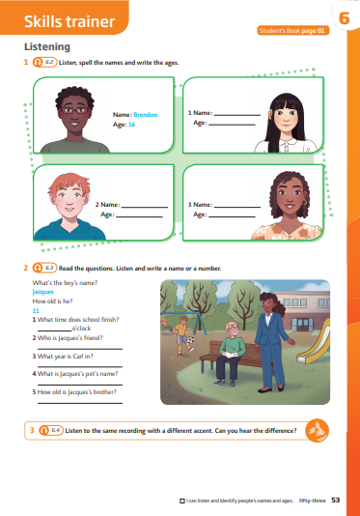
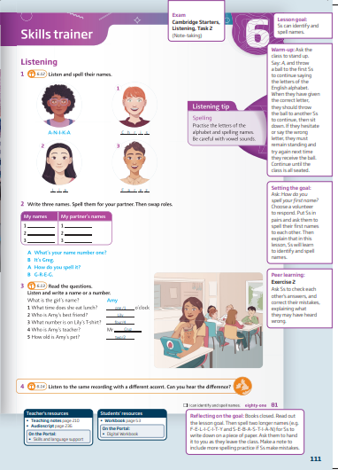
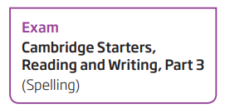
Exam preparation
exam preparation is seamlessly integrated into the SB &WB
exam preparation tasks are signposted in the Teacher’s Book
detailed information about exam tasks in the Teacher´s notes and the Exam Correlation Booklet online

Slide 21
There are detailed teaching notes and suggestions for how to adapt activities into more manageable formats if needed in the Teacher's Book.
Diversity and inclusion
All tasks in the Workbook progress from less to more difficult to allow teachers to allocate suitably graded material.
inclusive practices to reach all students' potential
the course offers various support materials across all components
Fast finishers activities in the Students' Book and the Workbook for more confident students.
Photocopiable Grammar maps for each grammar lesson for students who need a more guided explanation of target structures.

Slide 22

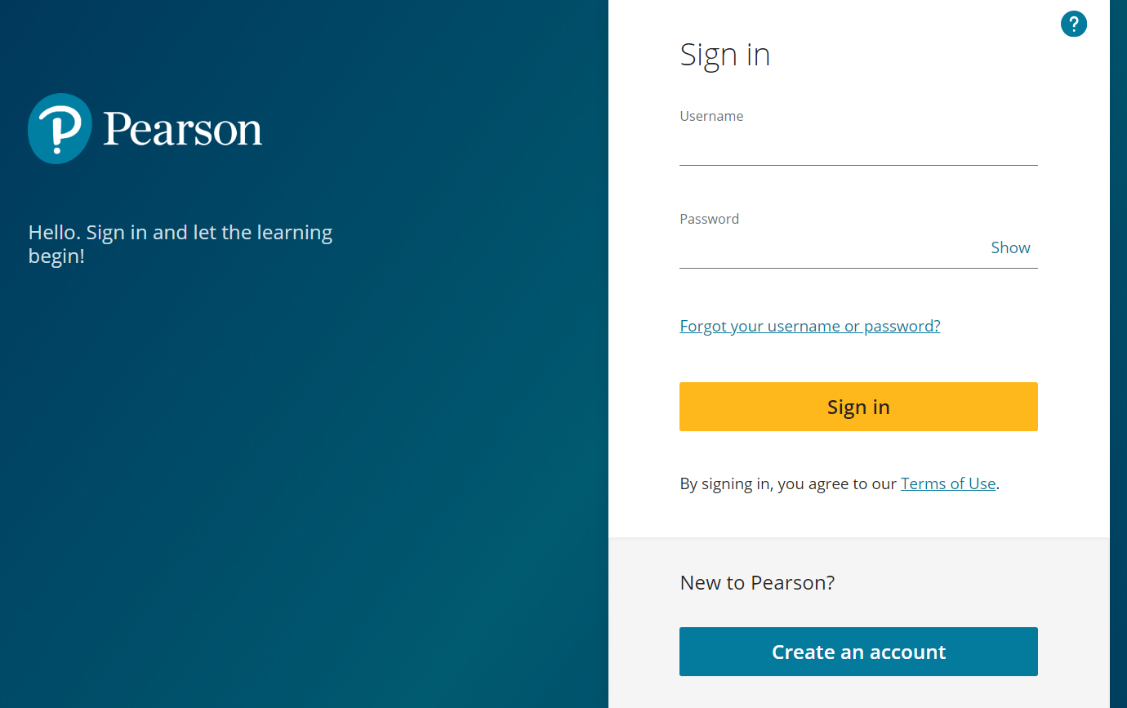
First class digital offer
create an accunt on the Pearson English Portal
https://english-dashboard.pearson.com
·

Slide 23
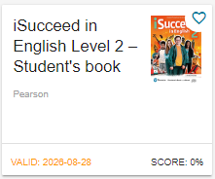
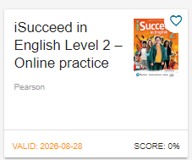
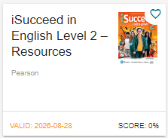
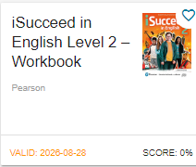
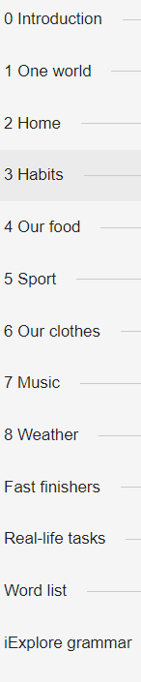
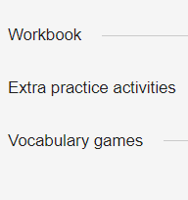
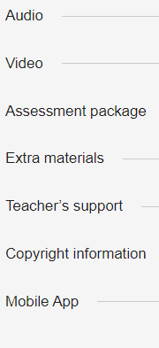
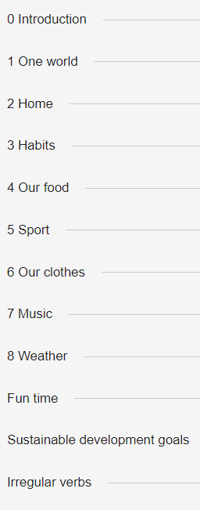
Pearson English Connect Walkthrough
Access Codes:
Students’ Book& eBook
Students’ Book& eBook +Online Practice
Workbook + Resources
Workbook + Online Practice
Standalone SB eBook
Standalone Online Practice
Standalone SB eBook + Online Practice

Slide 24
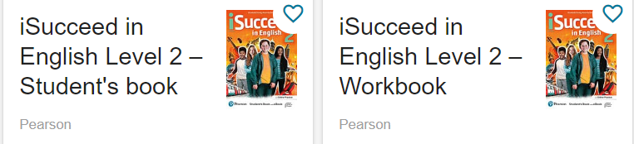
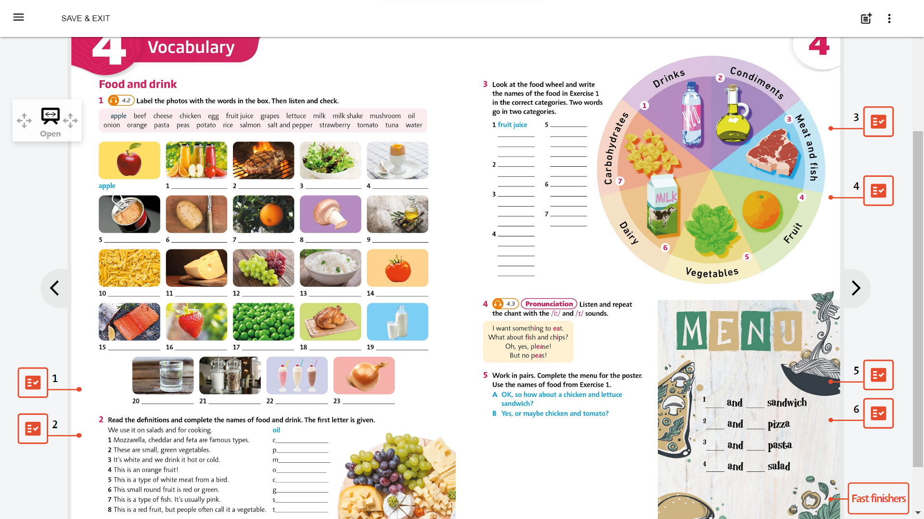
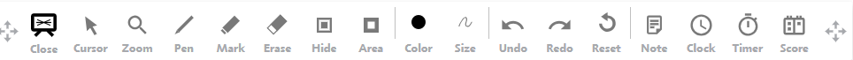
Presentation tool

Slide 25
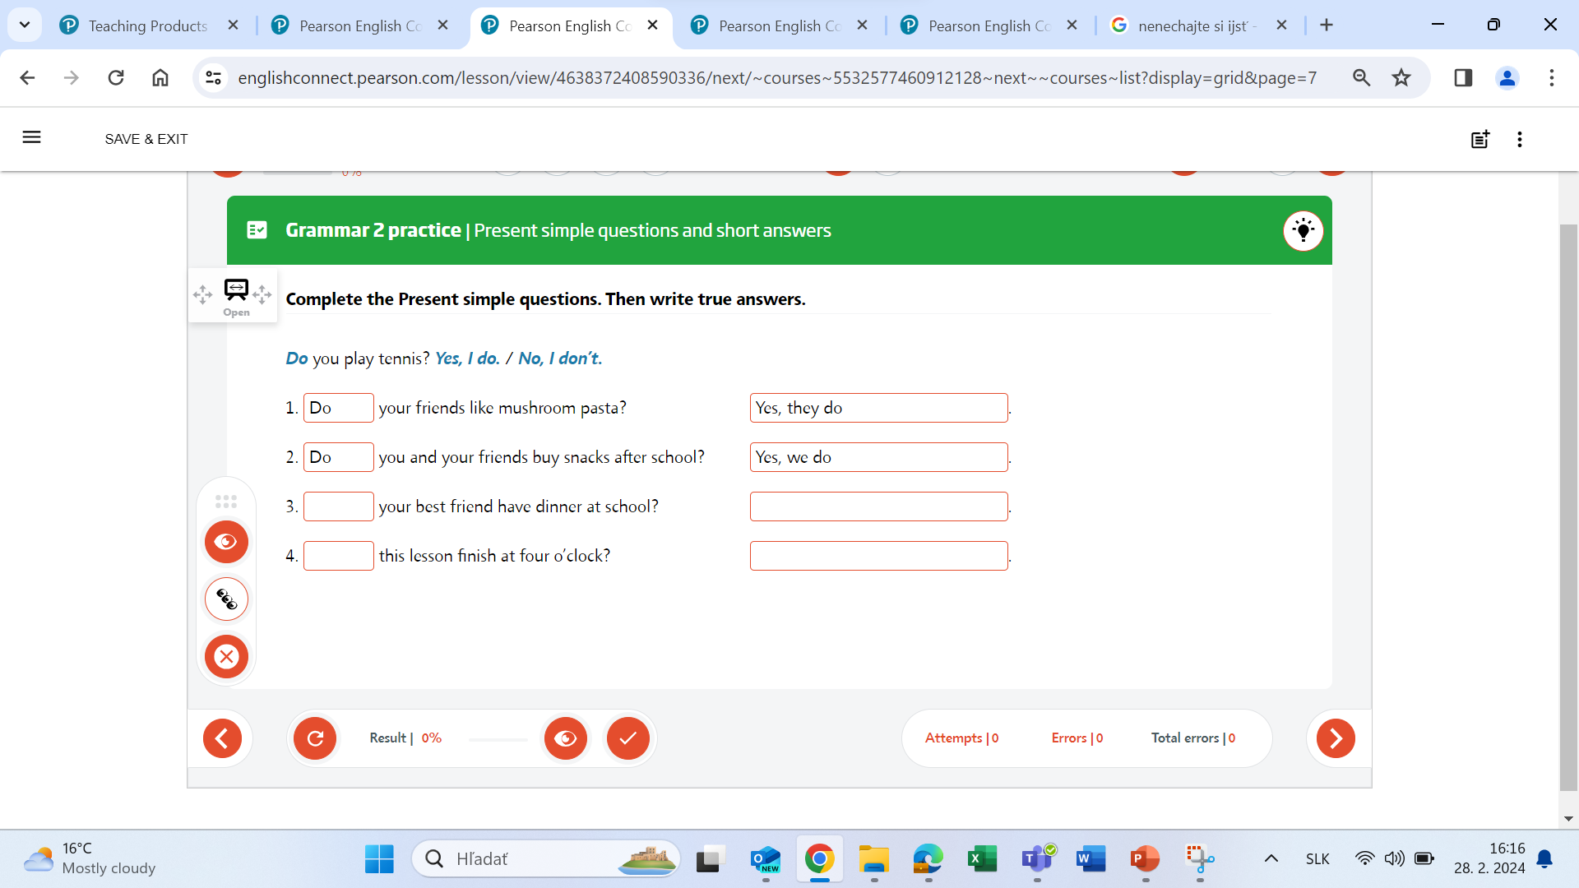
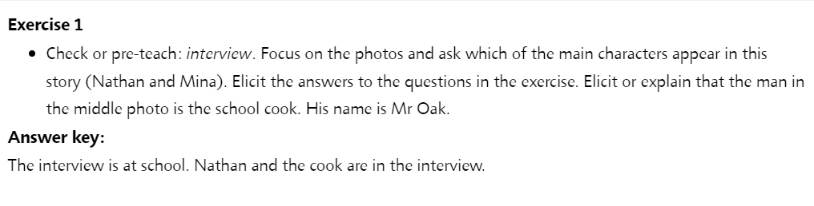
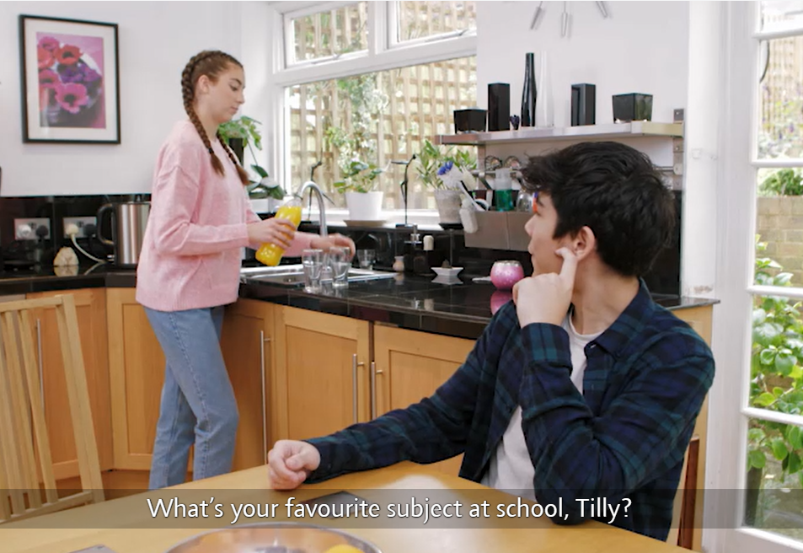
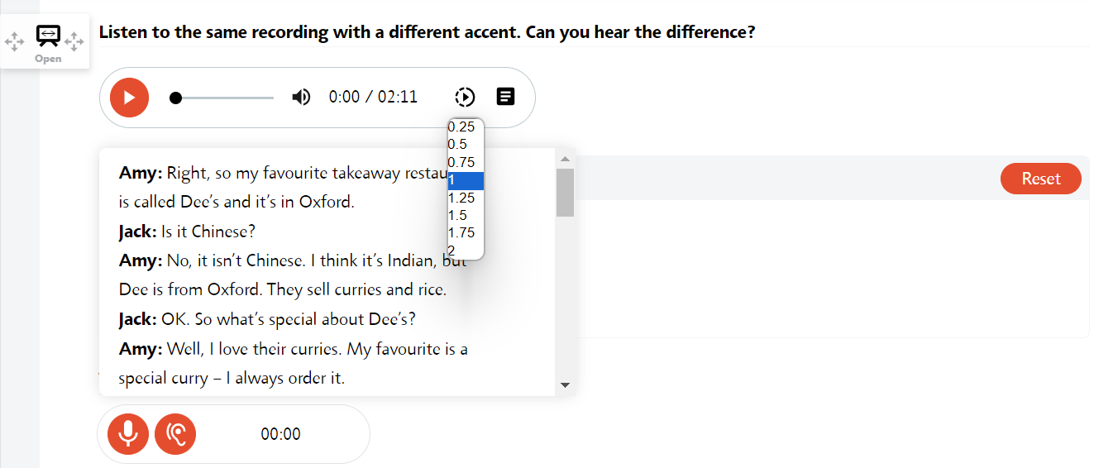

Slide 26
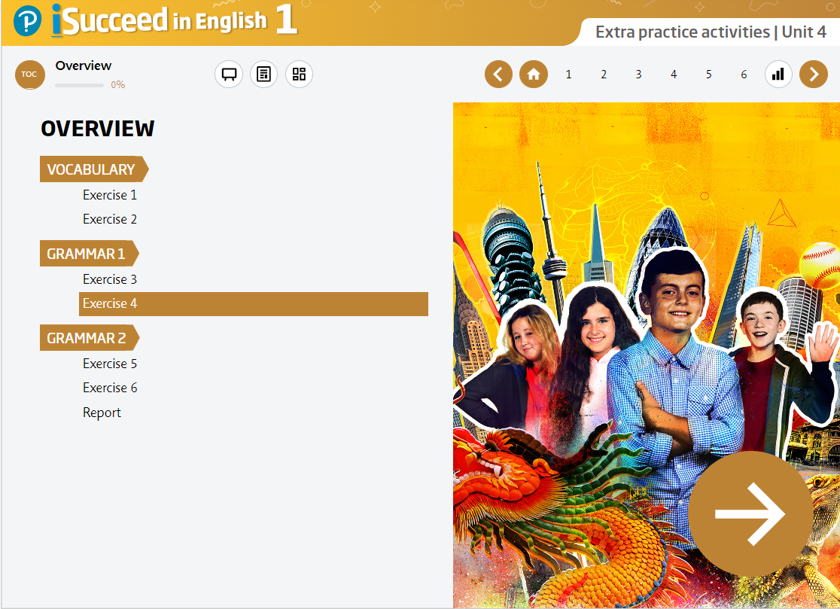
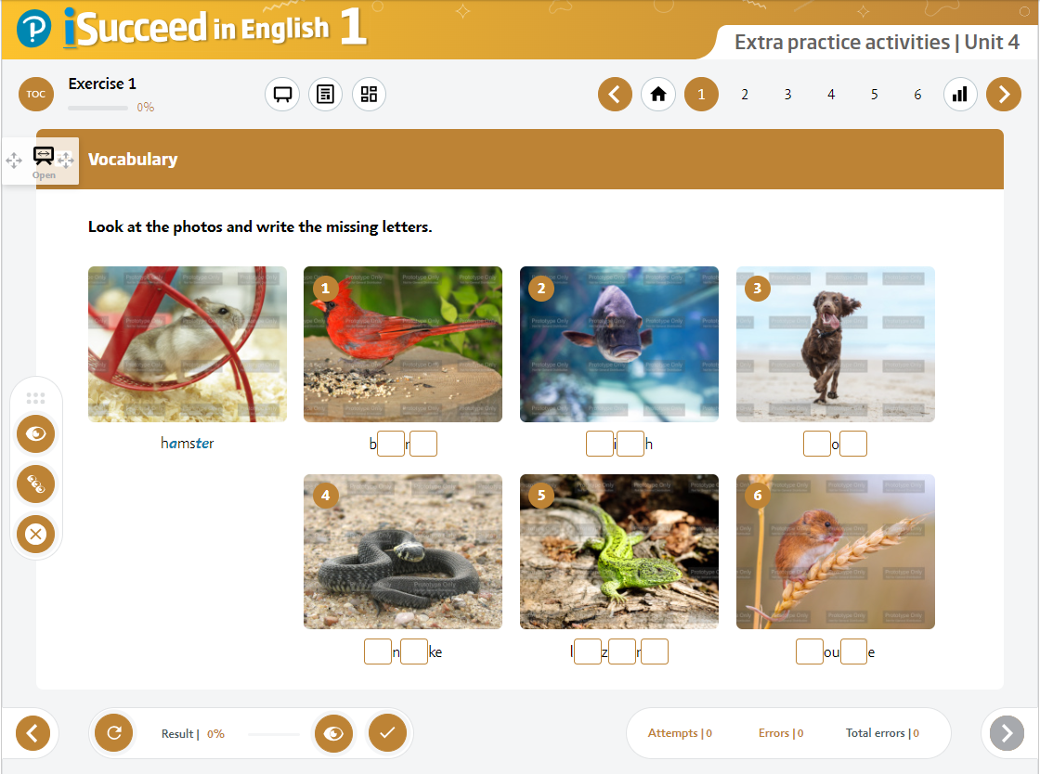
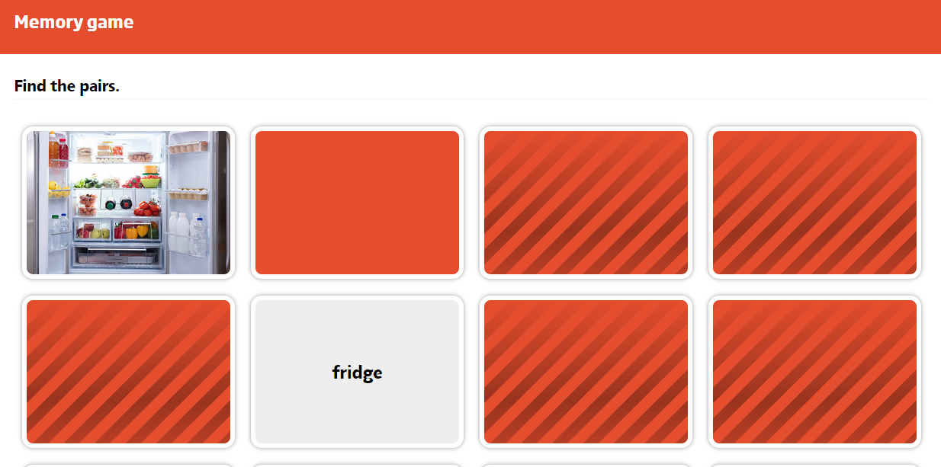
Extra practice activities with online practice (WB)
About 80 additional practice tasks for students per level: ​
4 grammar activities for each unit (36 per level) ​
2 vocabulary activities for each unit (36 per level) ​
1 Vocabulary Memory Games (8 per level)

Slide 27
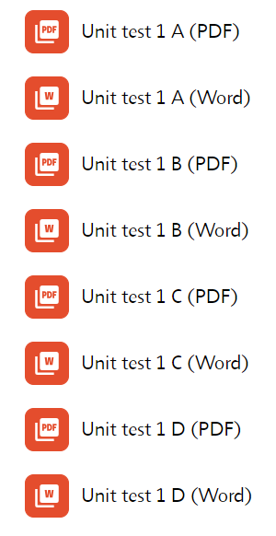
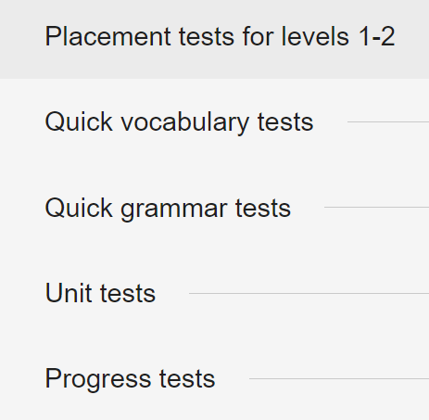
Assessment package
A standard test
B standard test
C support test
D for students with dyslexia

Slide 28
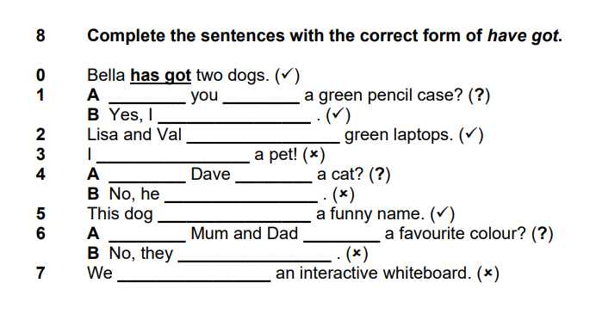
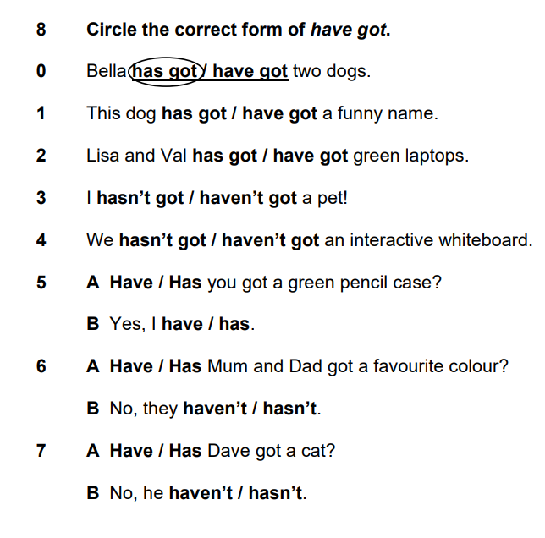
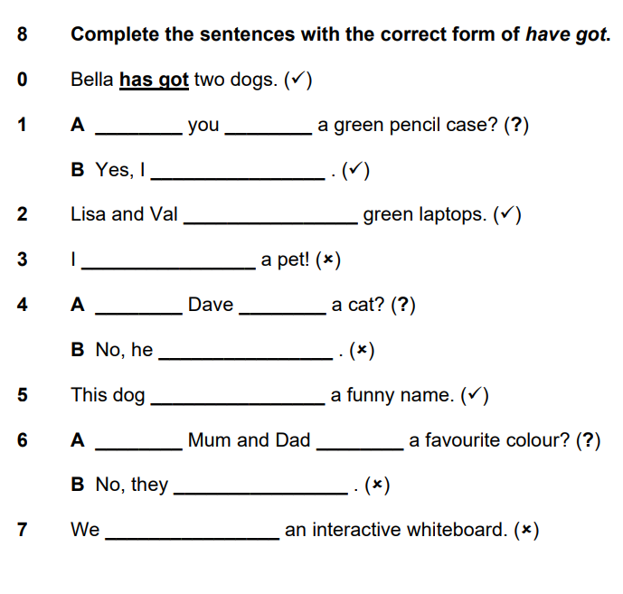
1
3
2

Slide 29
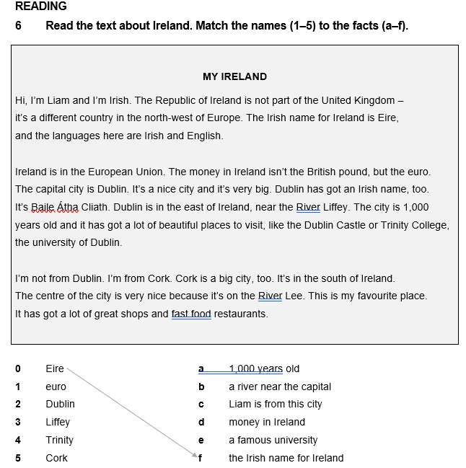
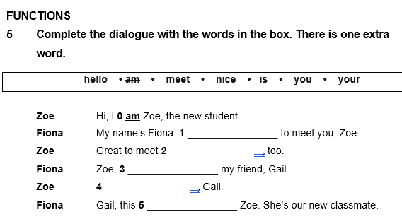
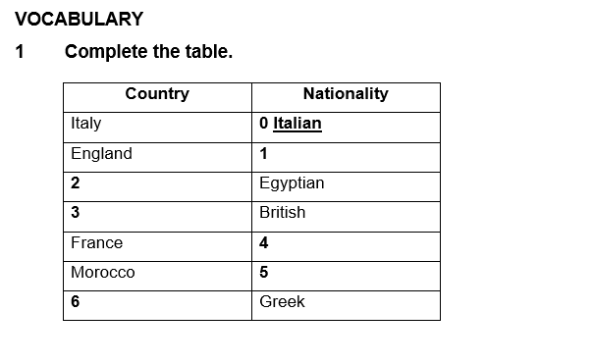
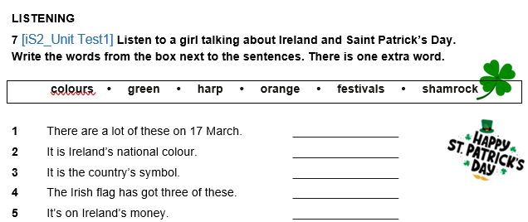
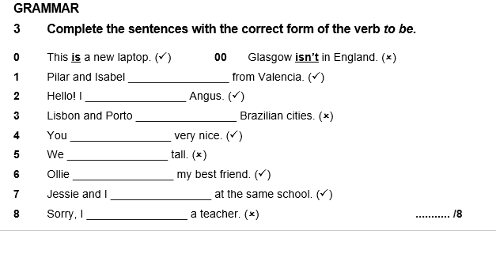
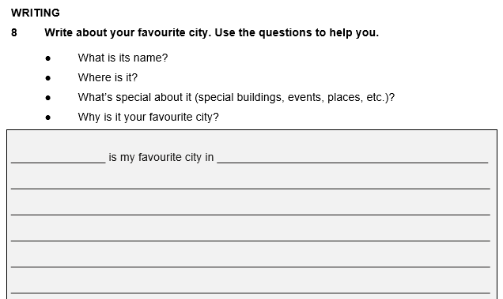
Test tasks

Slide 30
Extra materials
Photocopiable resources
Grammar maps
Grammar worksheets
Sustainable development goals worksheets
Citizenship video worksheets
Teacher´s support
Teaching notes
Future skills projects
GSE booklet
Exam correlation booklet
Distance teaching
Teaching with iSucceed in English videos
Course introduction
Student´s components
Teacher´s components
Extra lessons
Learn to learn
Culture
Songs
Readers

Slide 31
Unit Walkthrough
Level 2 Unit 4

Slide 32
Students’ Book
Introduction unit
8 units
Activities for fast finishers
Real-life tasks
Word list
access code to eBook
access code to eBook
and Online Practice

Slide 33
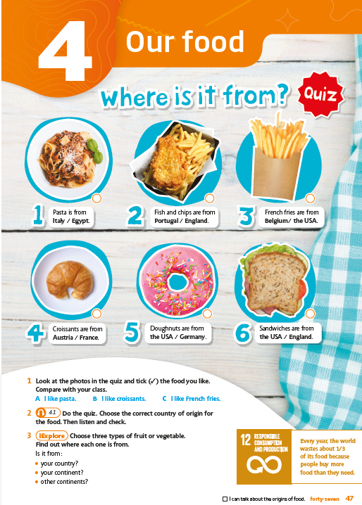
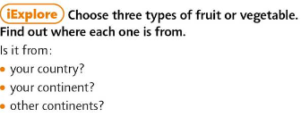

Unit Opener
topic presentation through an interesting context, attractive and inspiring visuals
iExplore tasks
Sustainable Development Goals

Slide 34
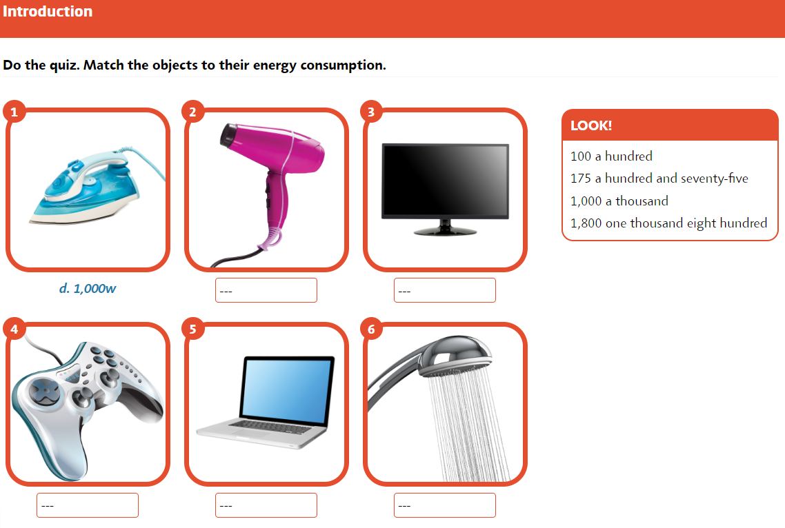
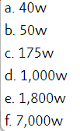
Level 2 Unit 2 Task 2

Slide 35

2 - e
3 - a
4 - c
5 - b
6 - f
Level 2 Unit 2 Task 2

Slide 36




Vocabulary
visual graphics
pronunciation practice based around funny chants
ativities for fast finishers

Slide 37

Grammar presentation 1
presentation using cartoons (level 1-3) and texts (level 4-5)
grammar animation with a mascot character
practice exercises from more controlled to more personalised
funny activities, games, quizzes

Slide 38



Grammar presentation 2
grammar presentation using story videos
cool talk with colloquial expressions
story extra videos (with one of the characters)
grammar animation with a mascot character
funny activities

Slide 39


Functions and Skills training
situational videos
guided speaking tasks
skills training
exam preparation
study tips

Slide 40


Culture and skills
visible thinking routine
listening activity with different accent
skills training tips
English- speaking countries topics
texts are recorded

Slide 41


Global citizens & CLIL (even units)
cross-curricular theme linked to Sustainable Development Goal
project work
visible thinking routines
from level 2 citizenship videos

Slide 42

Review
in every unit to help students for tests
consolidates the main grammar, vocabulary and functions of the units
a mini real-life task helps students to develop their future skills

Slide 43

Workbook
Introduction unit
8 units
Fun time activities
Sustainable Development Goals
activities
Answer key (Review units, Fun time
activities a SDG activities
access code
to audio and video resources
access code to Online Practice and Extra Practice Activities

Slide 44
Key features of
iSucceed in English?

Slide 45


Aligned to Sustainable Development Goals and focuses on global citizenship values
Very rich video package and multiple video styles
Integrated elements of Visible Thinking methodology
Seamlessly integrates exam preparation
Includes real-life stories and videos
to promote diversity and inclusion
Provides first class digital offer

Slide 46


Demo code
EESWHZ-FLAIL-ROVEN-WASTE-PETRI-PRISE
new customers
https://english-dashboard.pearson.com

Slide 47
Czechia
Kateřina Myšáková
katerina.mysakova@venturesbooks.com
Moravia
Lenka Nováková
lenka.novakova@venturesbooks.com
Slovakia
Judita Tóthová
judita.tothova@venturesbooks.com

